Slide 1

TOWN HALL MEETING MAY 8, 2024 7:00PM

Slide 2
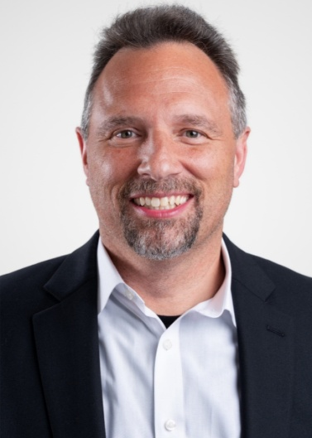
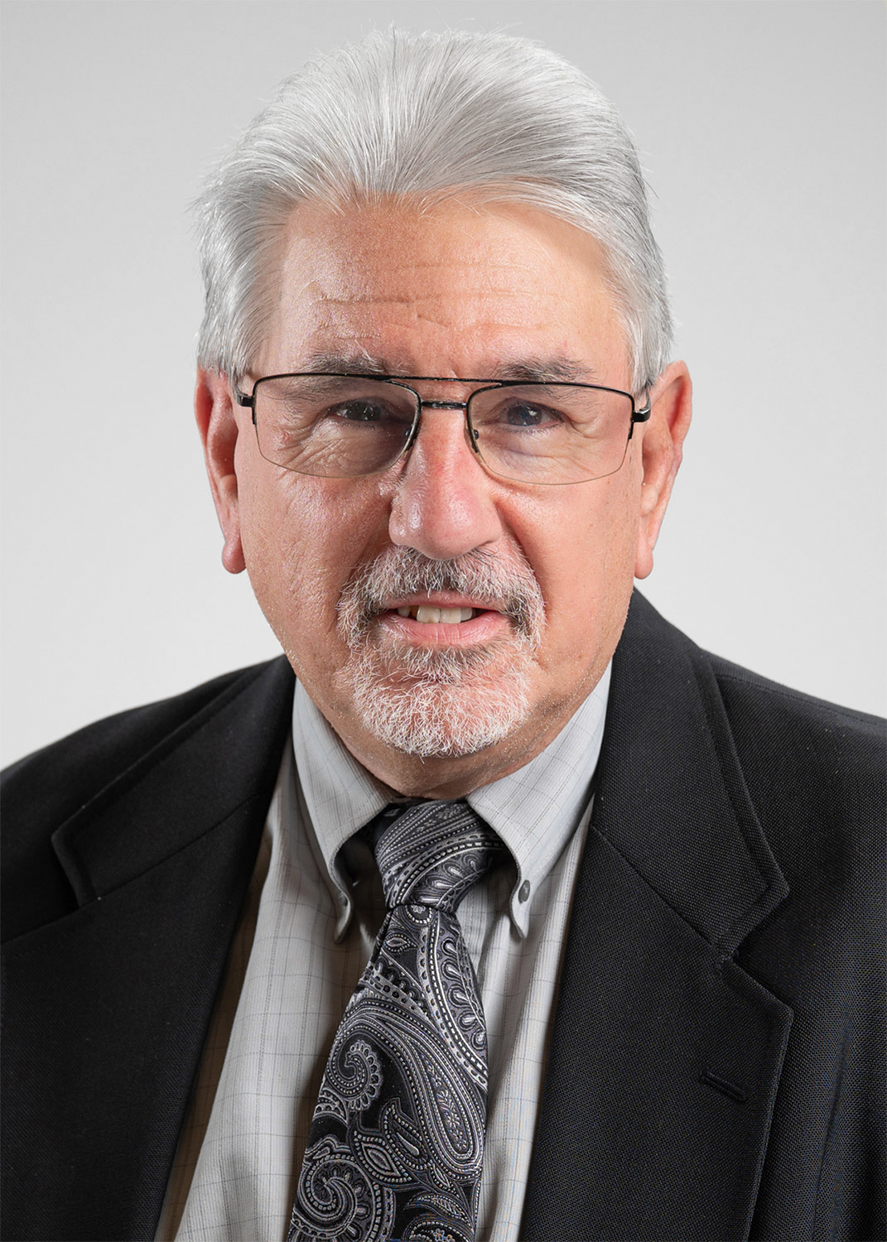
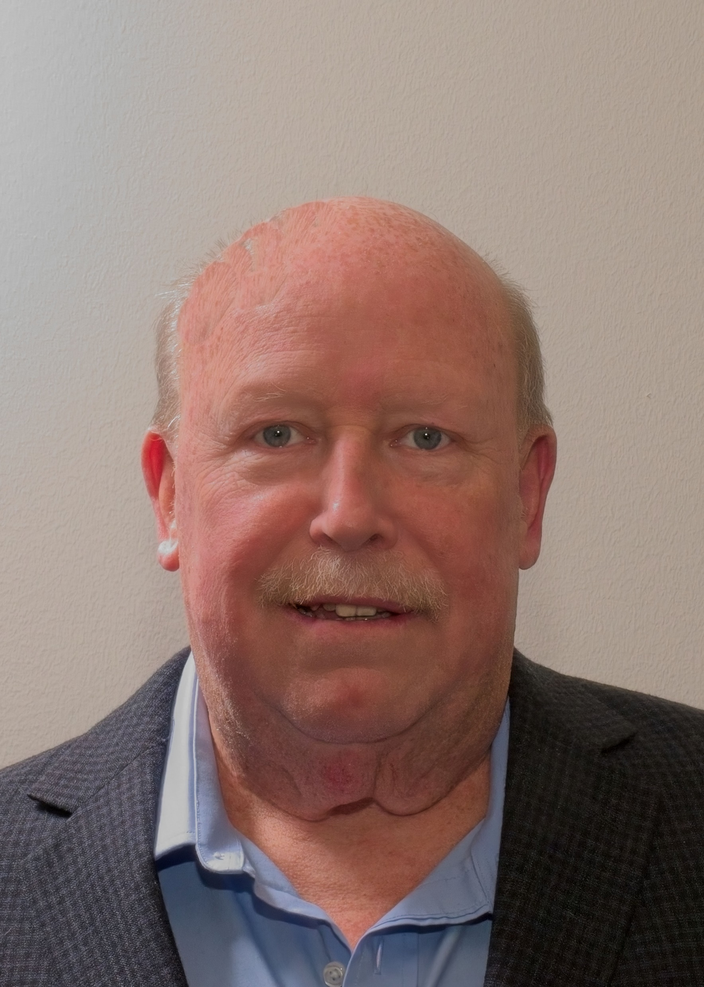

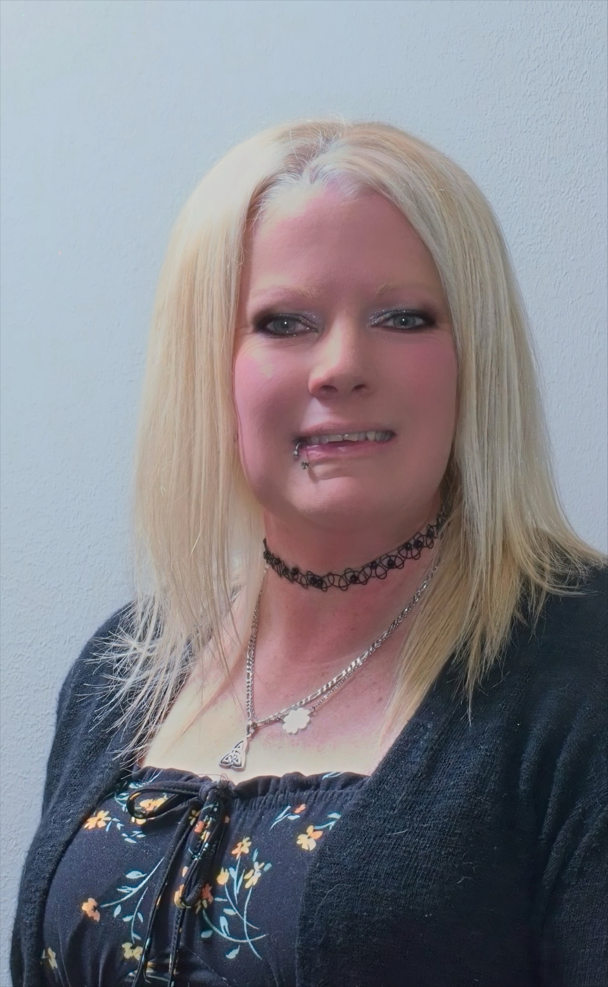
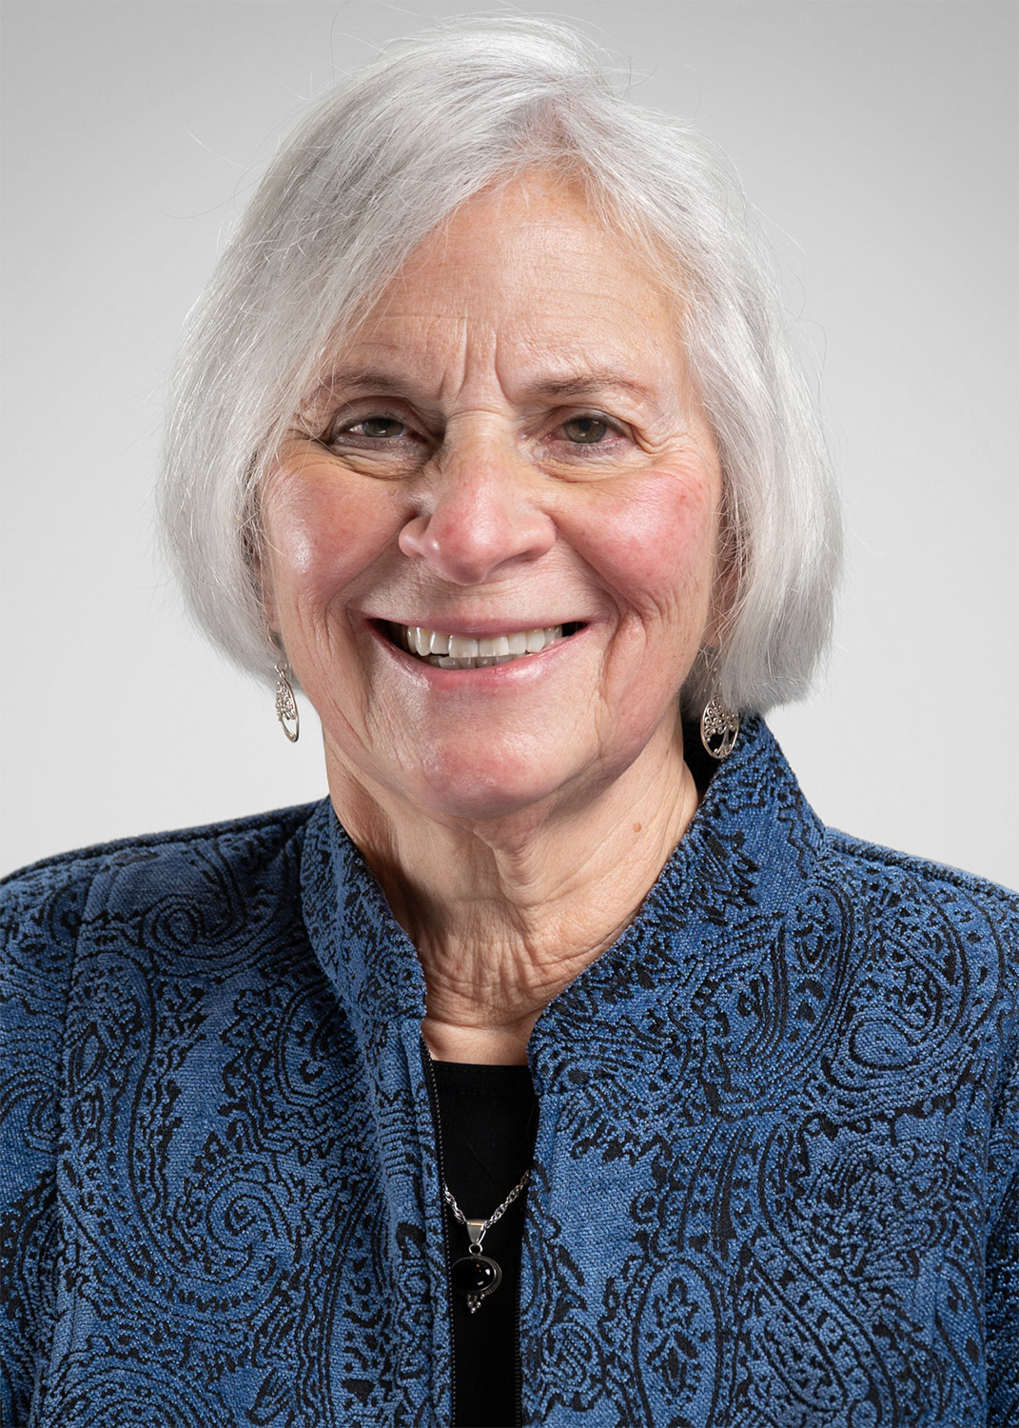
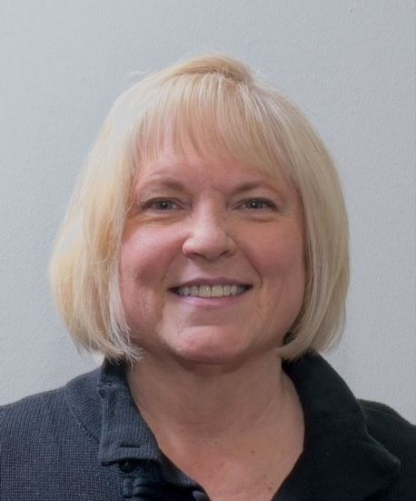
Elected Officials
Jason Ferguson
Council President
jferguson@hatfieldborough.com
Richard Girard
Council Vice President
rgirard@hatfieldborough.com
Larry Burns
Council Member
lburns@hatfieldborough.com
James Fagan
Council Member
jfagan@hatfieldborough.com
Michelle Kroesser
Council Member
mkroesser@hatfieldborough.com
Mary Anne Girard
Mayor
magirard@hatfieldborough.com
Marie Snyder
Tax Collector
taxcollector@hatfieldborough.com

Slide 3


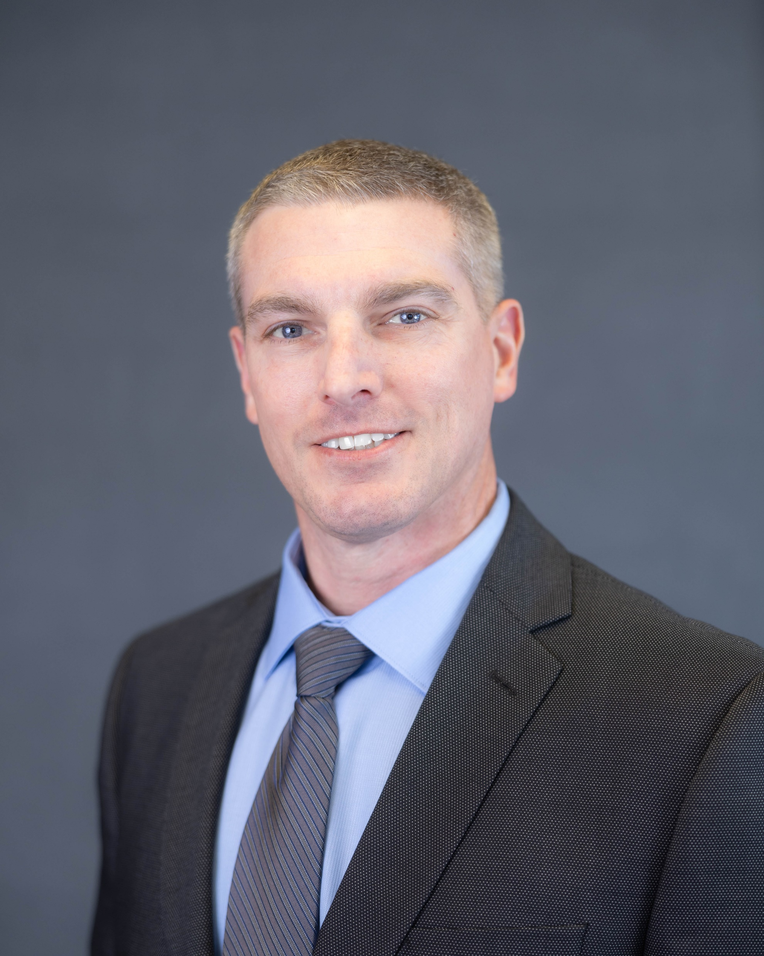

Presenters
Jaime E. Snyder
Borough Manager
jsnyder@hatfieldborough.com
215-855-0781 opt. 1
Stephen S. Fickert, Jr.
Borough Public Works Director
Electric Superintendent
sfickert@hatfieldborough.com
215-855-0781 opt. 2
Chad Camburn
Borough Engineer
Bursich Associates
A division on Van Cleef Engineering
Stephen Barth, President
Barth Consulting Group, LLC

Slide 4
AGENDA
Welcome and Introductions
2024 Financial Overview
2024 Budget
Debt Payments & Borrowing
Investments
2024 Projects Overview
Broad Street & N. Main Street Utility Replacement Project
ADA Curb Ramp Replacement Project
Roadway Resurfacing Project
General Utility Projects (electric, storm, sanitary sewer)
Communications
Utility Billing / E-Billing
Events
General
Contacts
Steve Barth, Barth Consulting Introduction and Revitalization Overview
Community Survey Overview:
The What & Why of the Community Survey?
Input from the Community
Resident Goals & Aspirations
Grants & Funding
Survey Questions & Responses:
Question Summaries
What the responses mean?
Low-Hanging Fruit
Long-Term - Goals
Next Steps:
Action Items
Concept Sketches
Grants
Concept Renderings:
Visioning Downtown
Architectural Features
Q&A: use Zoom feature email admin@hatfieldborough.com text 267-421-4753

Slide 5
2024 Financial Overview
2024 Budget
Debt Payments & Borrowing
Investments

Slide 6
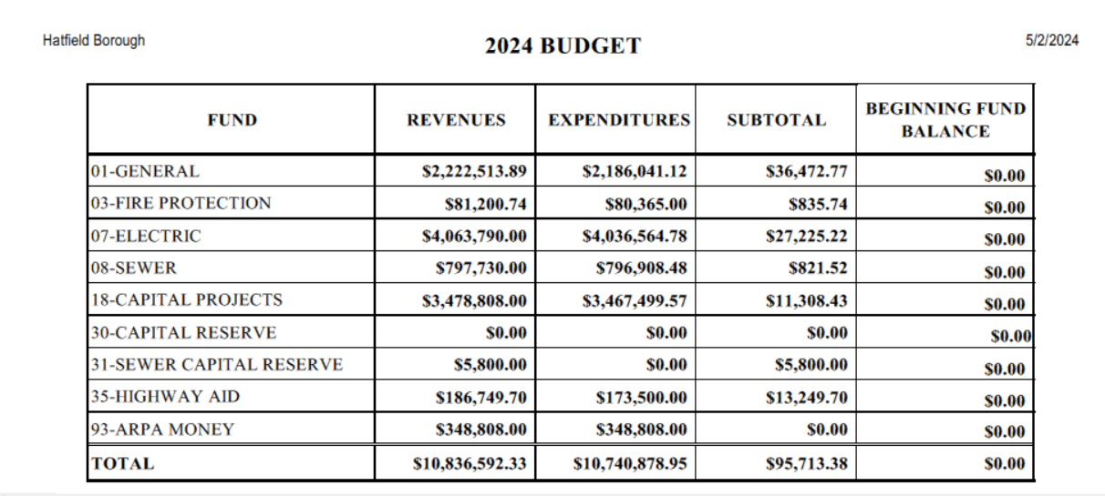
The approved 2024 operating budget of 10.8 million reflects NO INCREASE to the 3.25mil REAL ESTATE TAX that includes the FIRE TAX, and NO INCREASE in ELECTRIC or SEWER rates
Hatfield Borough 3 mils Hatfield Vol. Fire Company .25 mils TOTAL: 3.25 mils

Slide 7
2024 Budget
Tax Valuation
ESTIMATED INCOME ON $138,064,250 2024 VALUATION
.25 mil = $34,659.00
.50 mil = $69,319.00
.75 mil = $103,978.00
1 mil = $138,638.00
***HVFC receives .25 of the 3.25mils ($34,659.00) not included in revenue number of $414,915.00 for general account revenue purposes.
**all numbers are rounded for presentation purposes
INCREASE IMPACT BASED ON 2024 VALUATION
Average Home Valuation $143,071.00 2024:
2024: 3.25 mils = $481.84 / 12 = $40.15 (includes fire)
3.50 mils = $518.91 / 12 = $43.24
3.75 mils = $555.97 / 12 = $46.33
4.00 mils = $593.04 / 12 = $49.42
4.25 mils = $630.10 / 12 = $52.50
1 mil increase = average increase of $12.35 per month
Mil rate is a tax rate: the amount of tax payable per dollar of the assessed value of a property

Slide 8
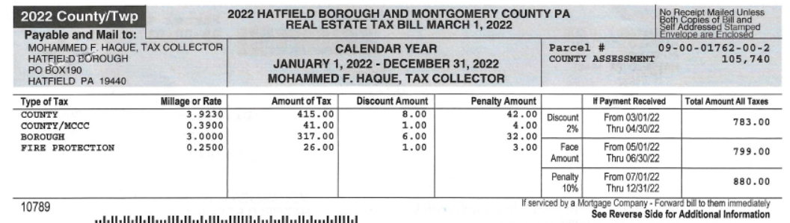
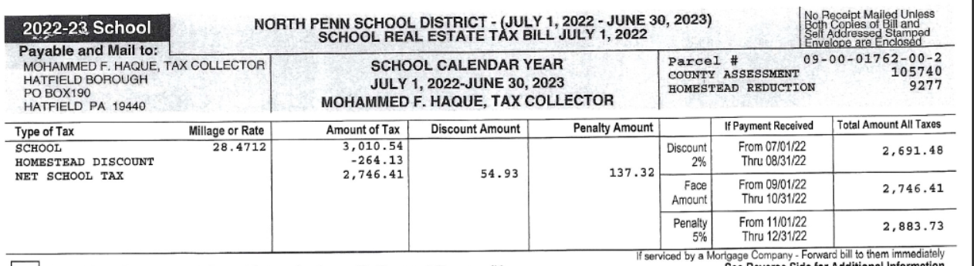
2024 Budget
Taxes
23rd lowest in RE Taxes in Montgomery County

Slide 9
2024 Budget
REVENUE HIGHLIGHTS
REAL ESTATE TRANSFER TAX $50,000.00 UP FROM $40,000.00 IN 2023
EARNED INCOME TAX (EIT) $455,000.00 UP FROM $425,000.00 IN 2023
LOCAL SERVICE TAX (LST) $45,000.00 UP FROM $35,000.00 IN 2023
SALE OF FIXED ASSETS $25,000.00 SALE OF OLD BACKHOE
TRANSFER FROM ELECTRIC $975,000.00 COVER PART OF THE POLICE SERVICES AGREEMENT OF $995,000.00 IN 2024
RE TAXES $414,915.00
BREAK DOWN $414,915.00 RE / $34,659.00 FIRE TAX = $449,574.00
**Estimated $964,915.00 in Tax Revenue

Slide 10
2024 Budget
EXPENSE HIGHLIGHTS
SEPTA $60,000.00 STEVE BARTH, BARTH CONSULTING GROUP
POLICE SERVICES $995,000.00 POLICE SERVICES FOR 2024 UP FROM $945,000.00 FROM 2023 (AGREEMENT THROUGH 2026)
VMSC FUNDING $15,000.00 ASKED FOR $24,000.00
EQUIPMENT PURCHASE $67,000.00 FOR THREE YEARS
CAP. CONSTRUCTION $100,000.00 POLE REPLACEMENT 7 RED TAGGED PLUS POLE
CAP. EQUIPT. PURCHASE $10,500.00 METERS AND INFRARED CAMERA
SEWER REPAIRS $9,000.00 $25,000.00 IN 2023
TELEVISING MAINS $15,500.00 TELEVISING MAINS AS WE DID PREVIOUSLY
PA H20 SMALL WATER $2,805.000.00 UTILITY PROJECT
CRUB RAMPS $20,000.00 ADA PROJECT: MAIN STREET $68,000.00 IN 2023
INLET / MAN HOLE $20,000.00 $20,000.00 IN 2023
CAPITAL CONSTRUCTION $158,500.00 ROADWAY RESURFACING PROJECT
**General Expenses, wages, benefits, property maintenance, building maintenance, and parks maintenance are shown on the detailed budget at www.hatfieldborough.com **2025 Budget Presentation November 13, 2024 7:00PM

Slide 11
Debt Payments and Borrowing
2021 Series Notes A & B
April 2024 Paid $1,281,000.00
May 2024 Will Pay $93,000.00
**after payments post will rework the repayment schedule
2020 Series Notes:
Principal Payment of $396,000.00
Interest Payment of $30,085.77
Total: $426,085.77
2021 Series Notes A & B:
Principal Payment of $24,000.00 / $67,000.00
Interest Payment of $8,129.25 / $17,256.21
Total A & B: $116,385.46
2024 Series Notes A & B
2.8 Million Dollar Utility Replacement Project. 1.8 Grant Funded.
A Note Est. 3.9% rate $23,984.00 in 2024
B Note Est. 4% rate $35,409.00 in 2024
**looking to borrow after the bid is awarded
Total needed for 2024 as of 1/1/24: $542,471.23
+ $99,000.00 repayment for AMI @ 4%

Slide 12
Investments
Electric Managed T-Bills
Federal Cost Mature to Par Cost
6 Month 9/5/2024 $243,599.00 $250,000.00
24 Month 2/22/2026 $240,230.00 $250,000.00
24 Month 2/15/2025 $238,447.00 $250,000.00 (10 months left)
Sewer Managed T-Bills
6 Month 9/26/2024 $243,551.00 $250,000.00
2023 Year End the Electric Managed account was up 8.8% from 2022.
**all investment purchases were made at an interest rate above 4%

Slide 13
2024 Projects Overview
Broad Street & N. Main Street Utility Replacement Project
ADA Curb Ramp Replacement Project
Roadway Resurfacing Project
General Utility Projects (electric, storm, sanitary sewer)

Slide 14
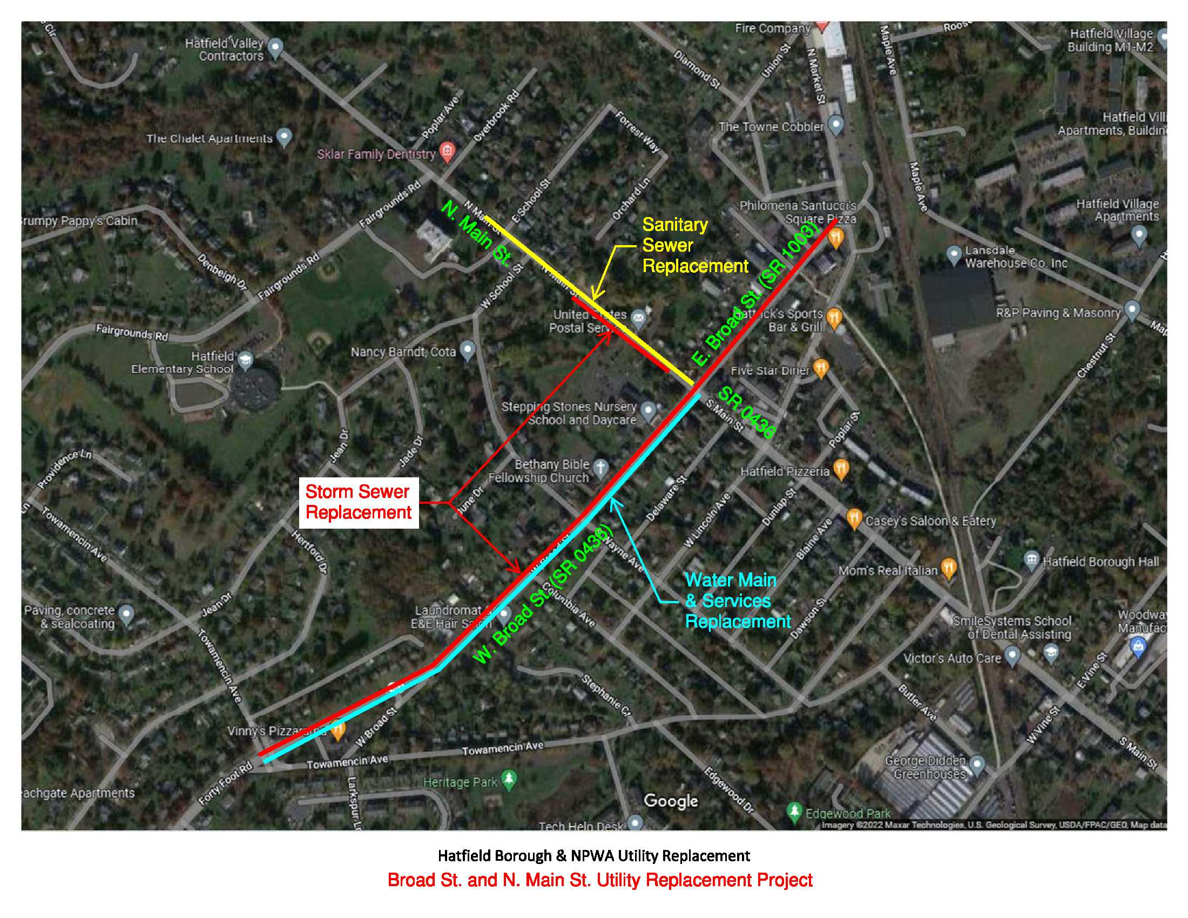
Broad Streets & N. Main Street
Utility Replacement Project

Slide 15
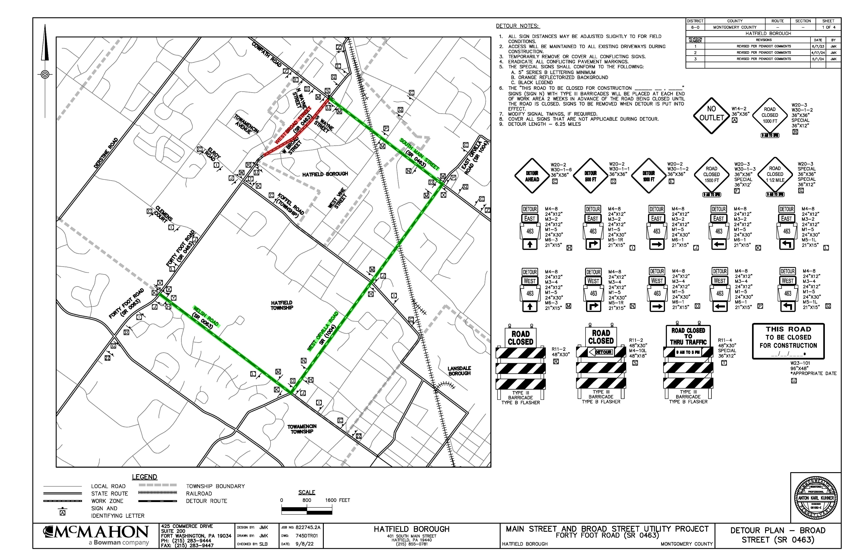
Broad Streets & N. Main Street Utility Replacement Project
Detour Plans

Slide 16
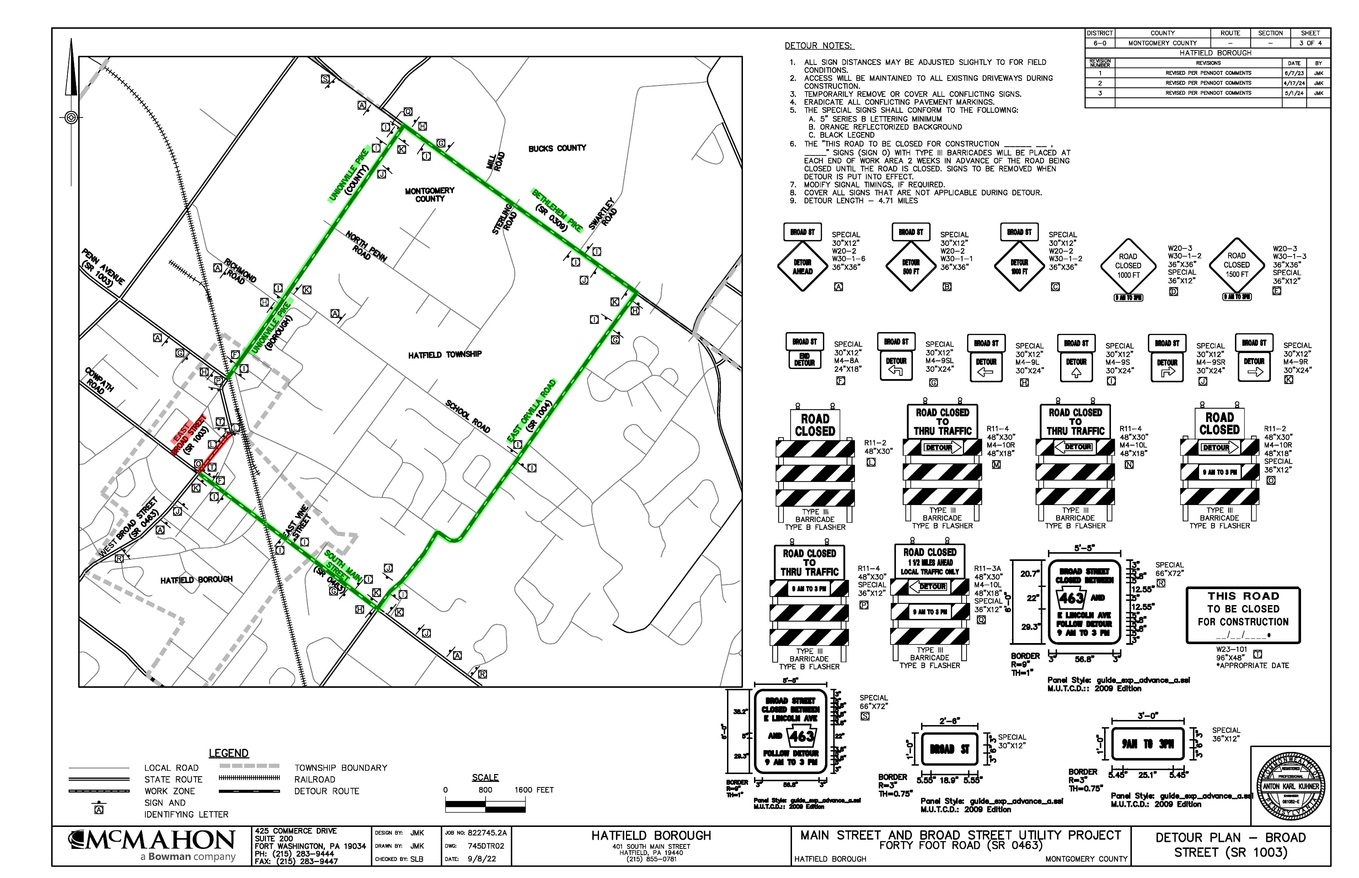
Detour Plans Cont.

Slide 17
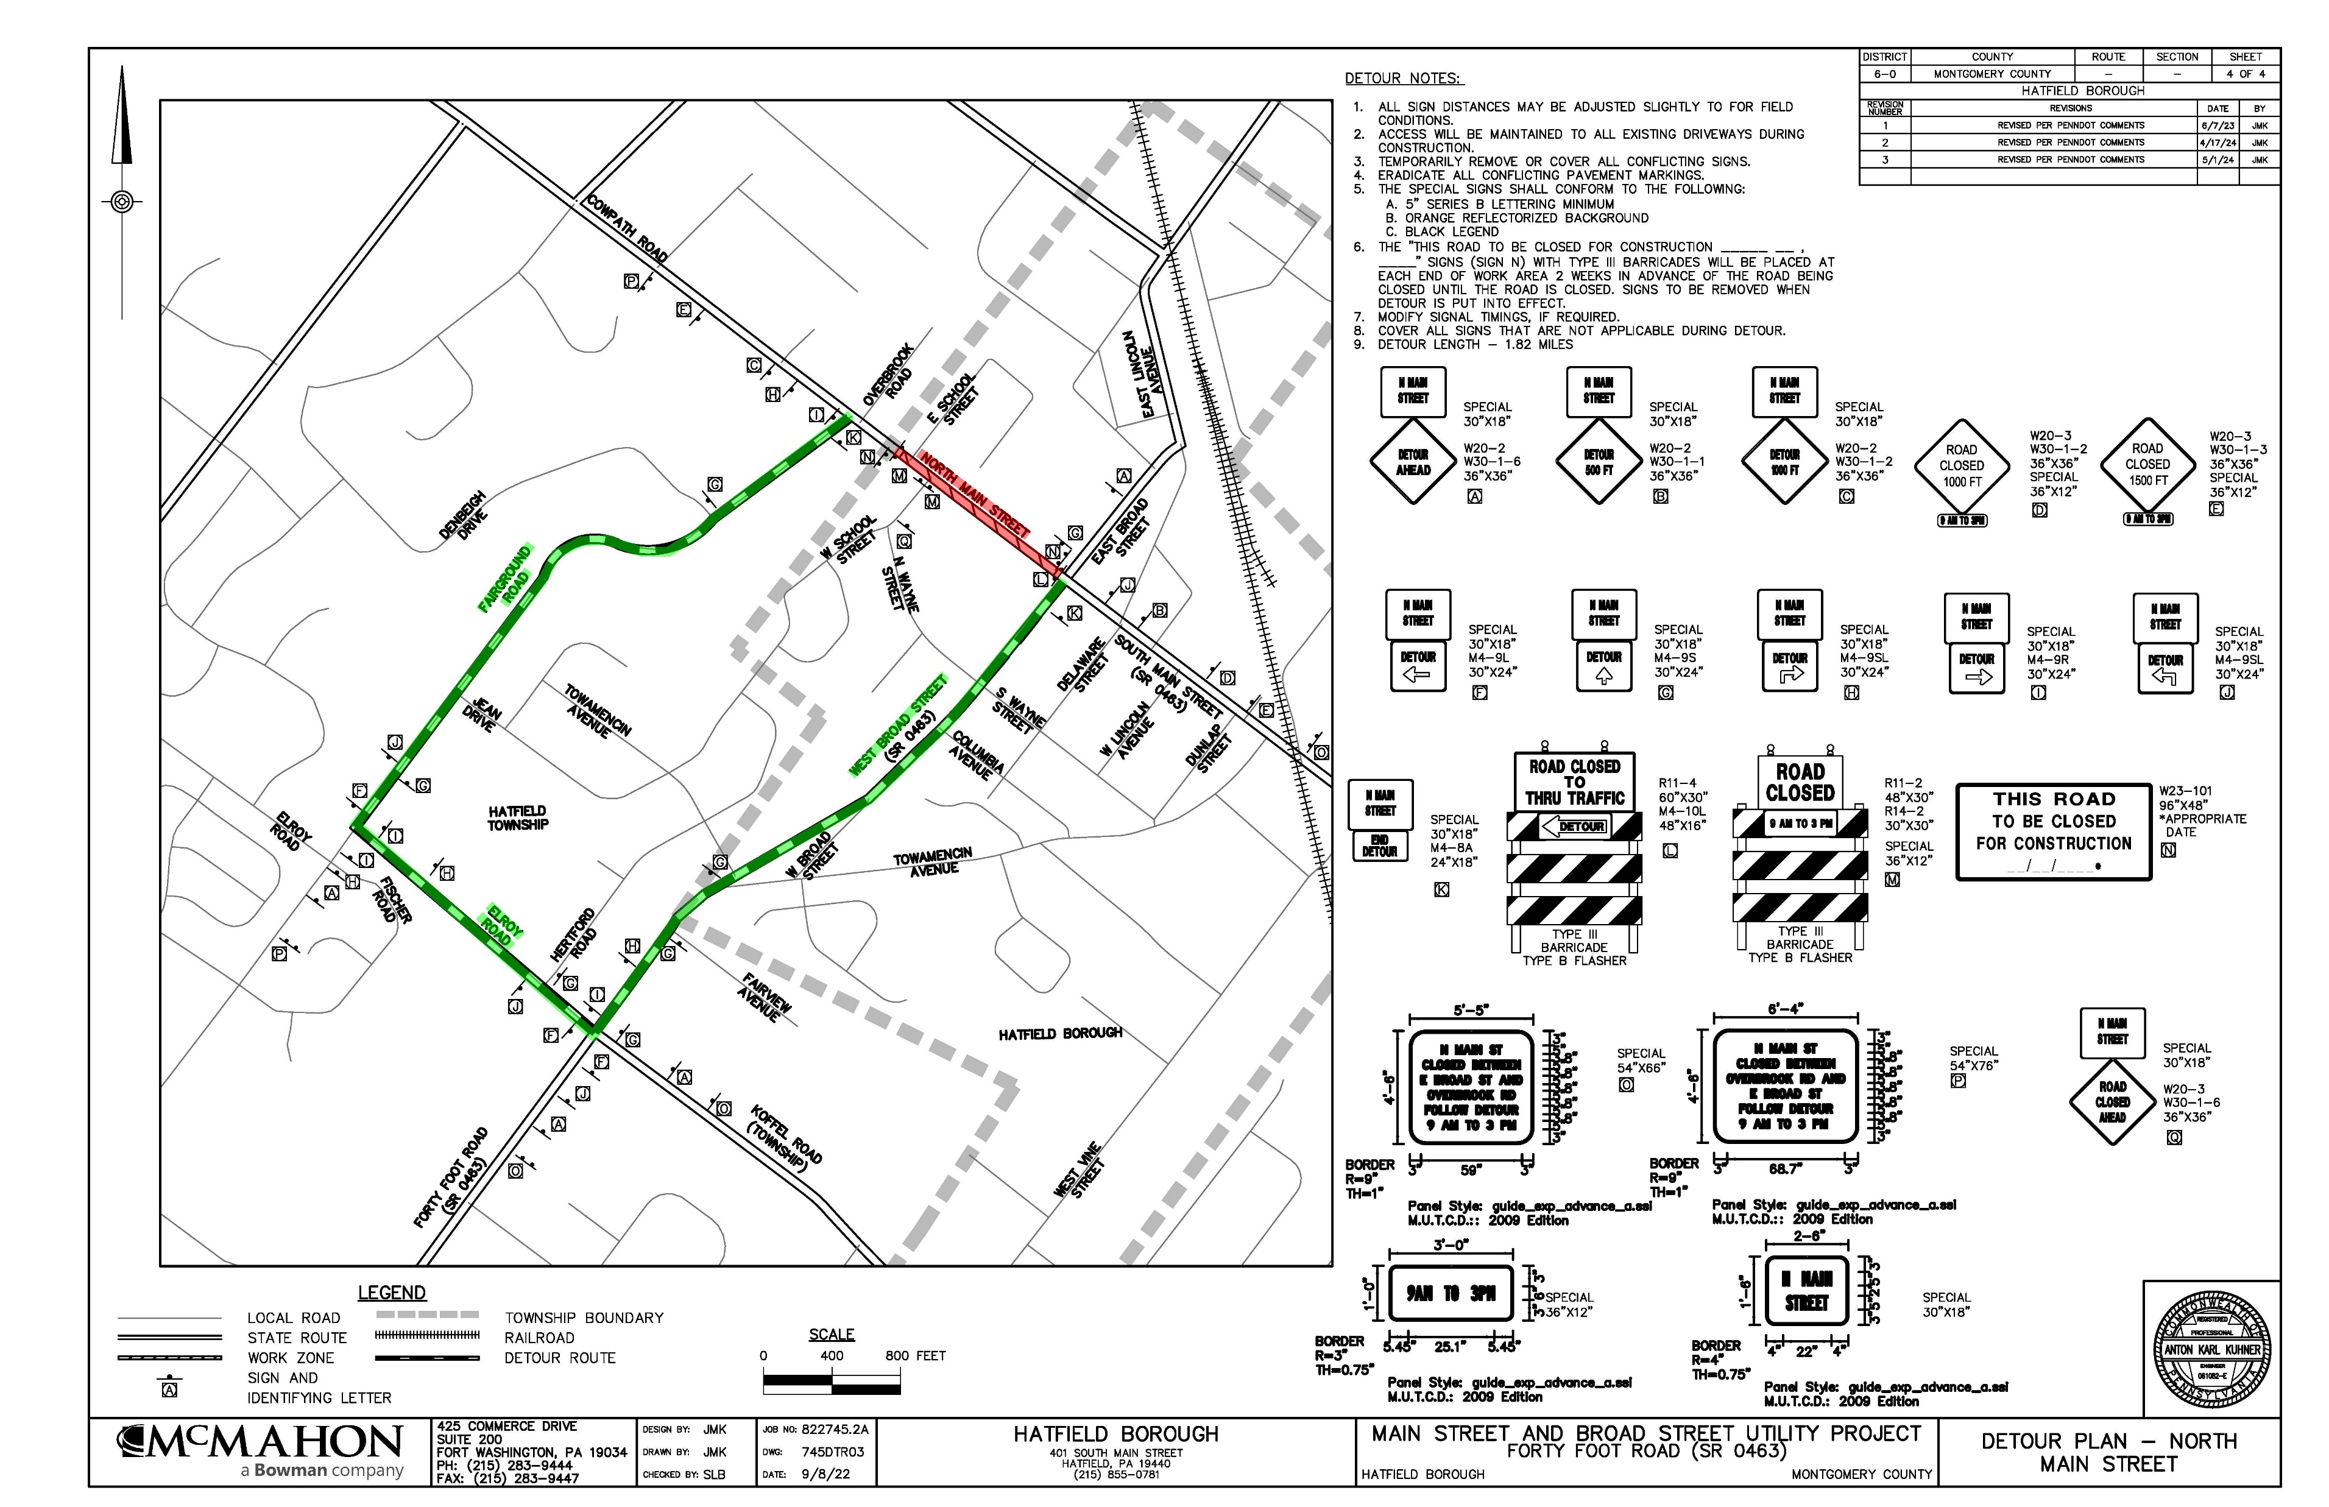
Detour Plans Cont.

Slide 18
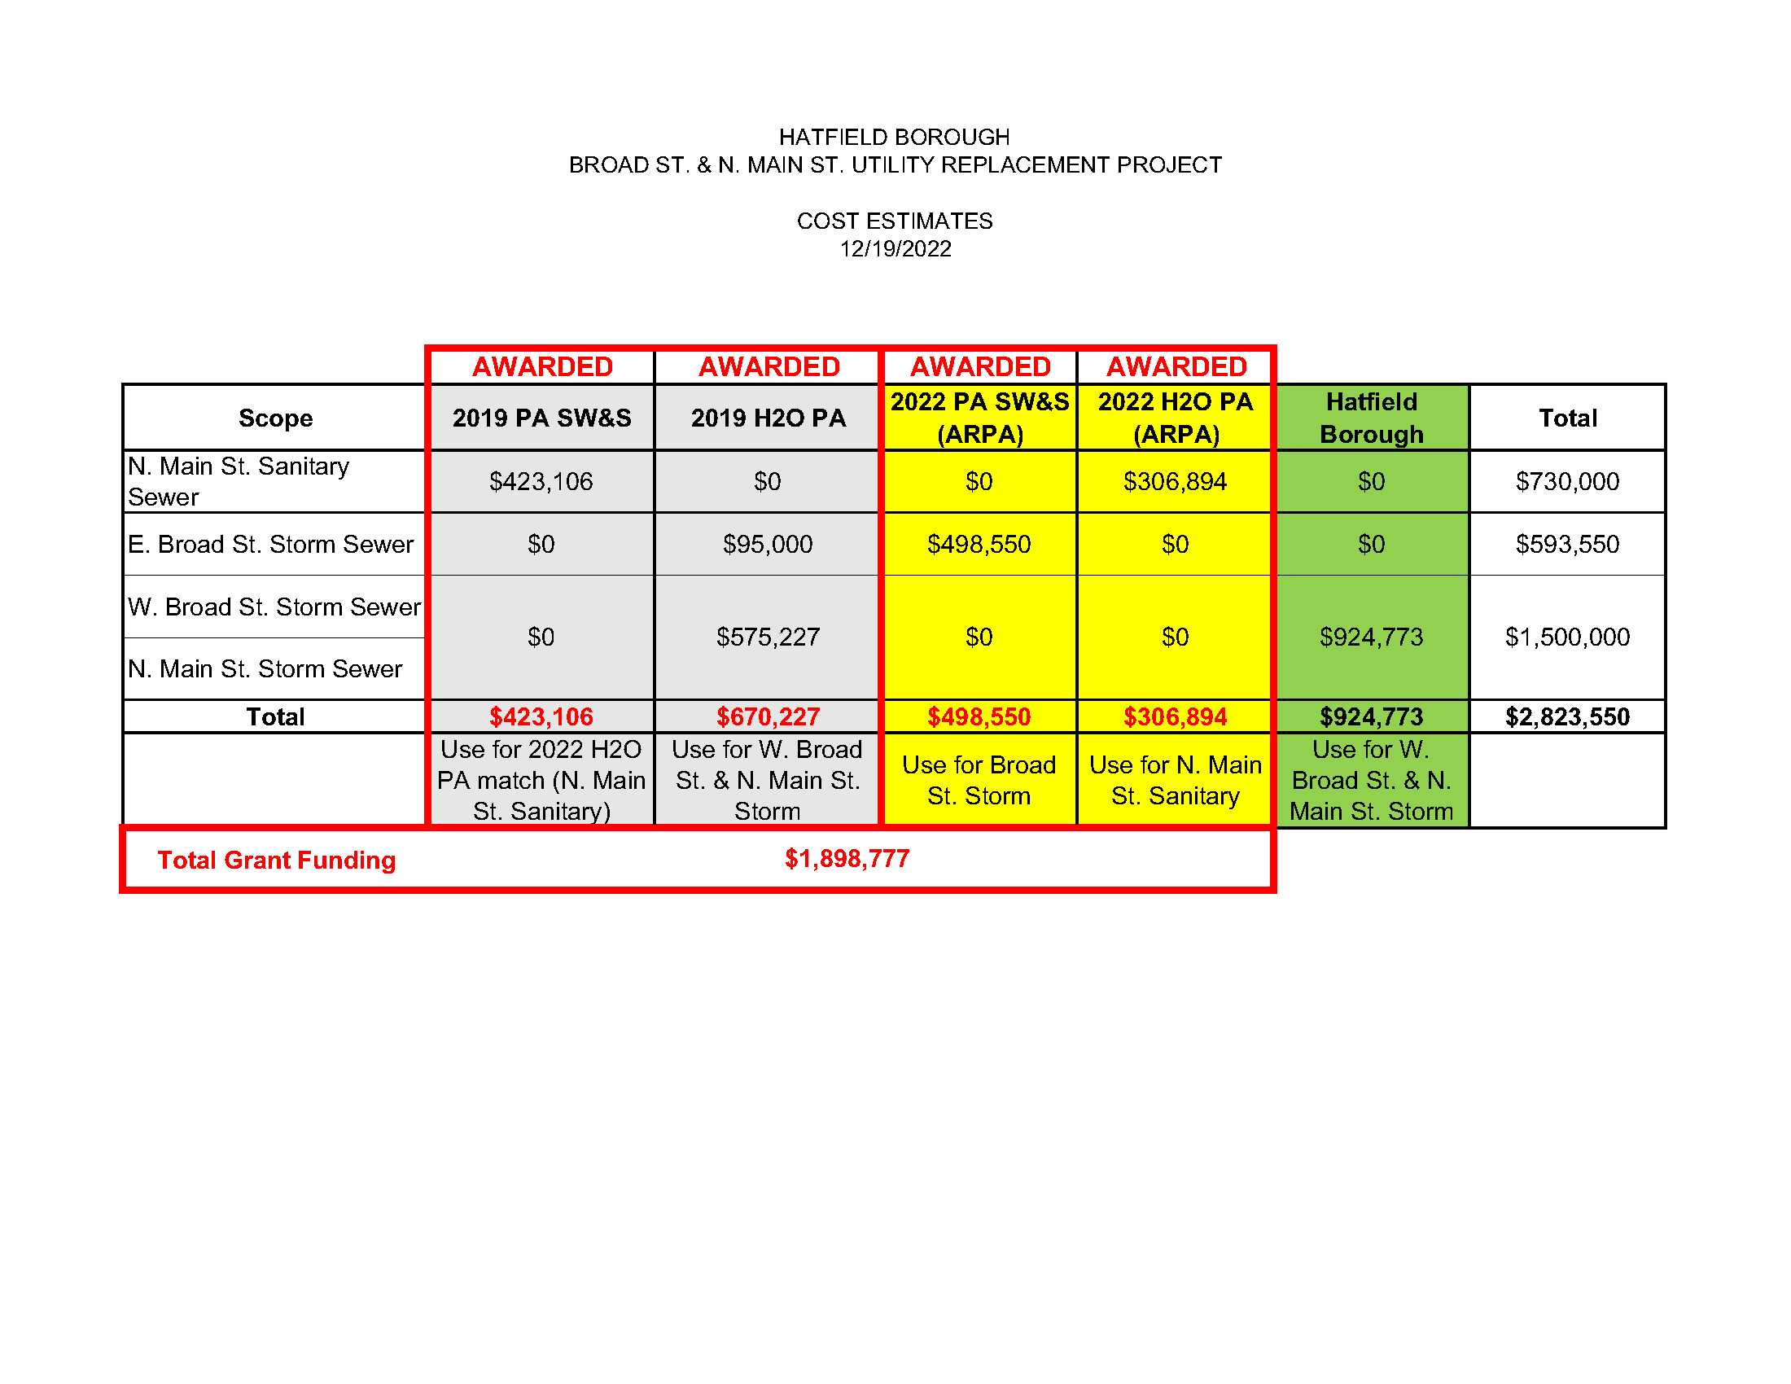
Broad Streets & N. Main Street
Utility Replacement Project
Grants

Slide 19
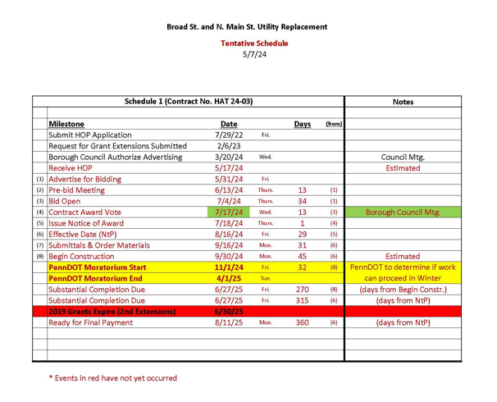
Broad Streets & N. Main Street
Utility Replacement Project
Tentative Schedule

Slide 20
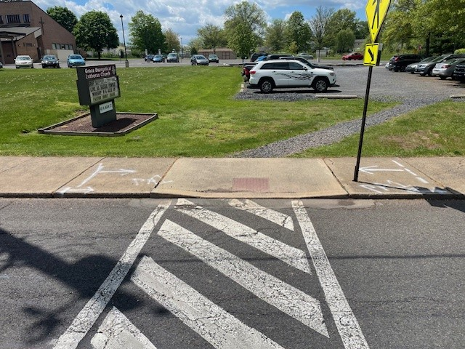
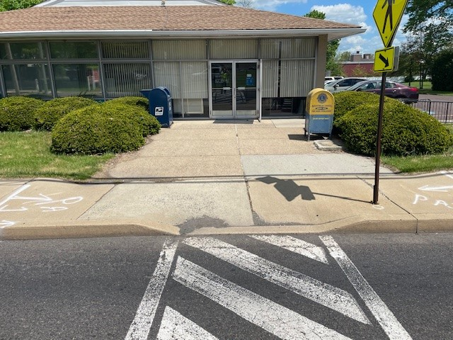
ADA Curb Ramp Replacement Project

Slide 21
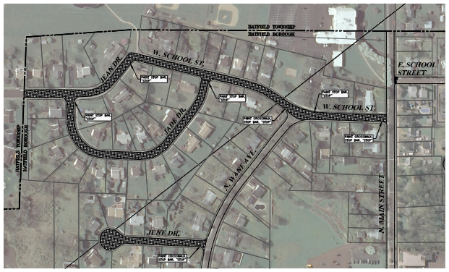
Roadway Resurfacing Project

Slide 22
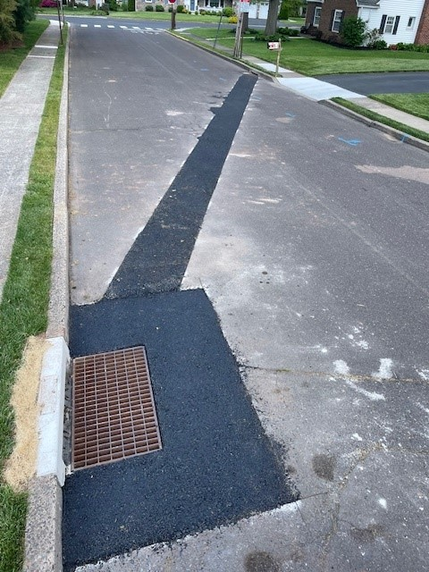
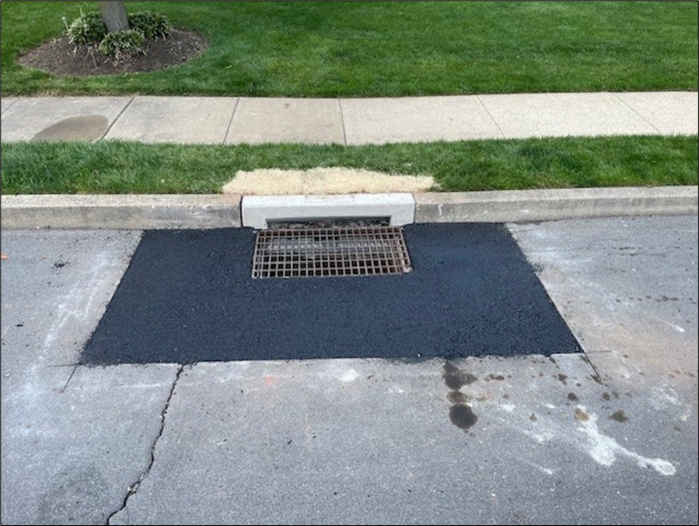
General Utility Projects

Slide 23
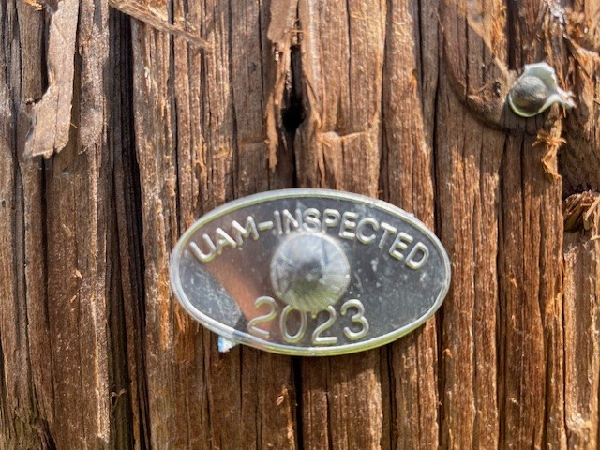
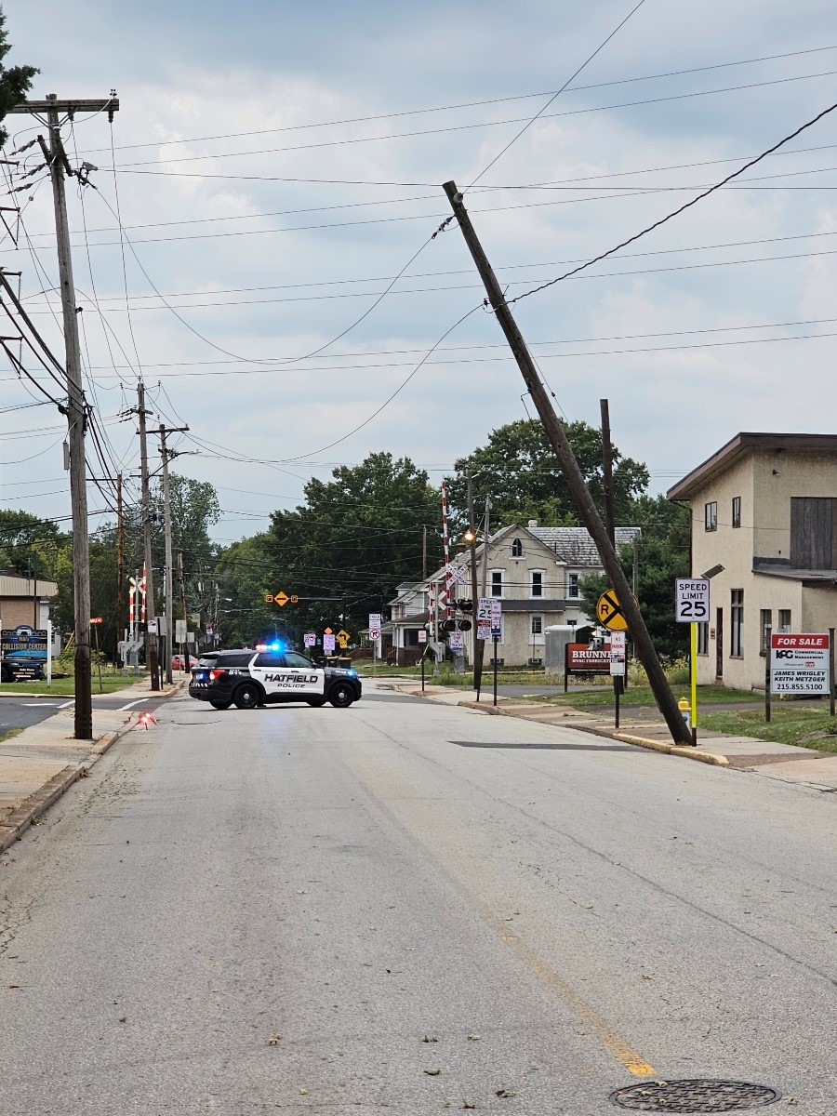
General Utility Projects

Slide 24
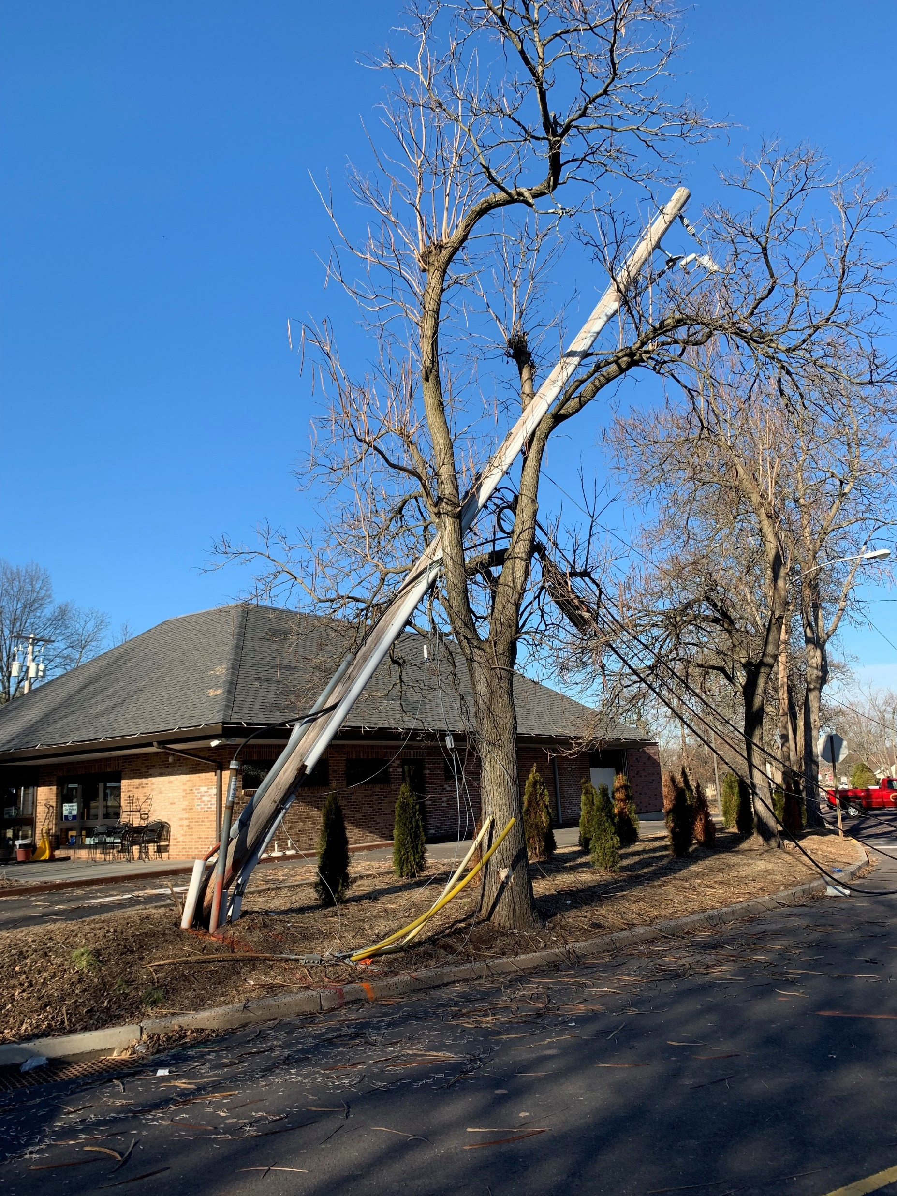
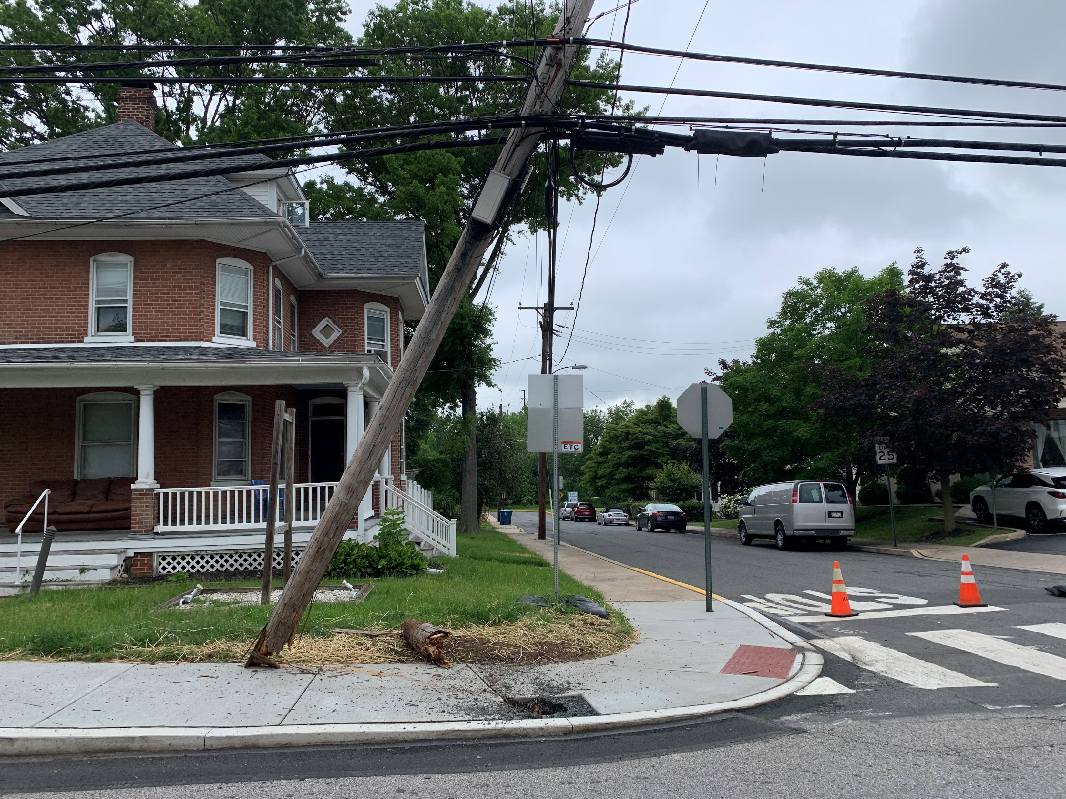
General Utility Projects

Slide 25
Communications
Utility Billing / E-Billing
Events
General
Legislative Contacts
Borough Staff

Slide 26
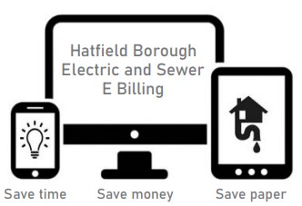
Utility Billing / E-Billing
Did you know that Hatfield Borough customers can now receive their utility bills conveniently via email?
Say goodbye to paper bills! With email billing, your electric and sewer bills go directly to your inbox, eliminating the need to wait for mail delivery or the chance of misplacing the paper copy. Enjoy the flexibility of accessing your bills anytime, anywhere. Email billing offers instant delivery and is an eco-friendly choice that helps the Borough cut costs on printing and postage, ultimately keeping expenses low.
To sign up, contact the Hatfield Borough Office at
215-855-0781 (option 4) or email utilitybilling@hatfieldborough.com.

Slide 27

2024 Event Information

Slide 28
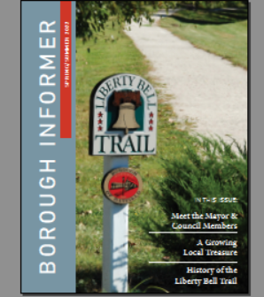





Information Resources
Hatfield Borough19440
@HatfieldBorough
@HatfieldBorough19440
Hatfield Borough, PA
https://member.everbridge.net/index/453003085612338#/signup
www.hatfieldborough.com
admin@hatfieldborough.com

Slide 29
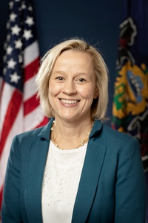
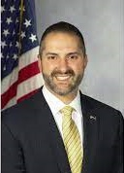
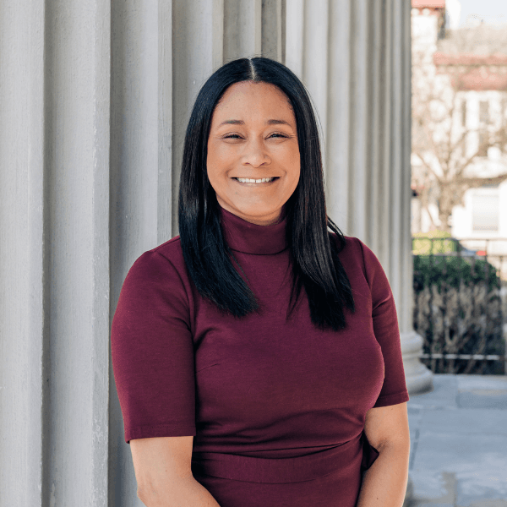

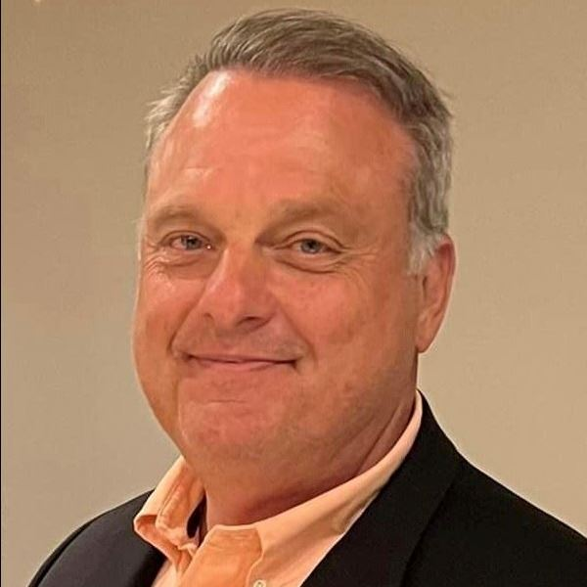
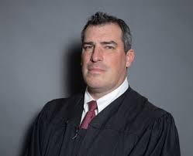
State and County Elected Officials
State Senator Maria Collett
Gwynedd Corporate Center
1180 Welsh Road
Suite 130
North Wales, PA 19454
(215) 368-1429
State Representative Steve Malagari
Lansdale Office
100 West Main Street
Suite 110
Lansdale, PA 19446
(267) 768-3671
Commissioner
Jamila H. Winder
Chair
Commissioner
Neil Makhija
Vice Chair
Commissioner
Thomas DiBello
P.O. Box 311
Norristown, PA 19404-0311
Phone: 610-278-3000 Hours 8:30 a.m.- 4:15 p.m.
District Court 38-1-28 Judge Edward Levine Pennbrook Parkway Lansdale PA (215) 393-7534
District Includes: Townships of Towamencin and part of Hatfield and Boroughs of Hatfield and Lansdale

Slide 30
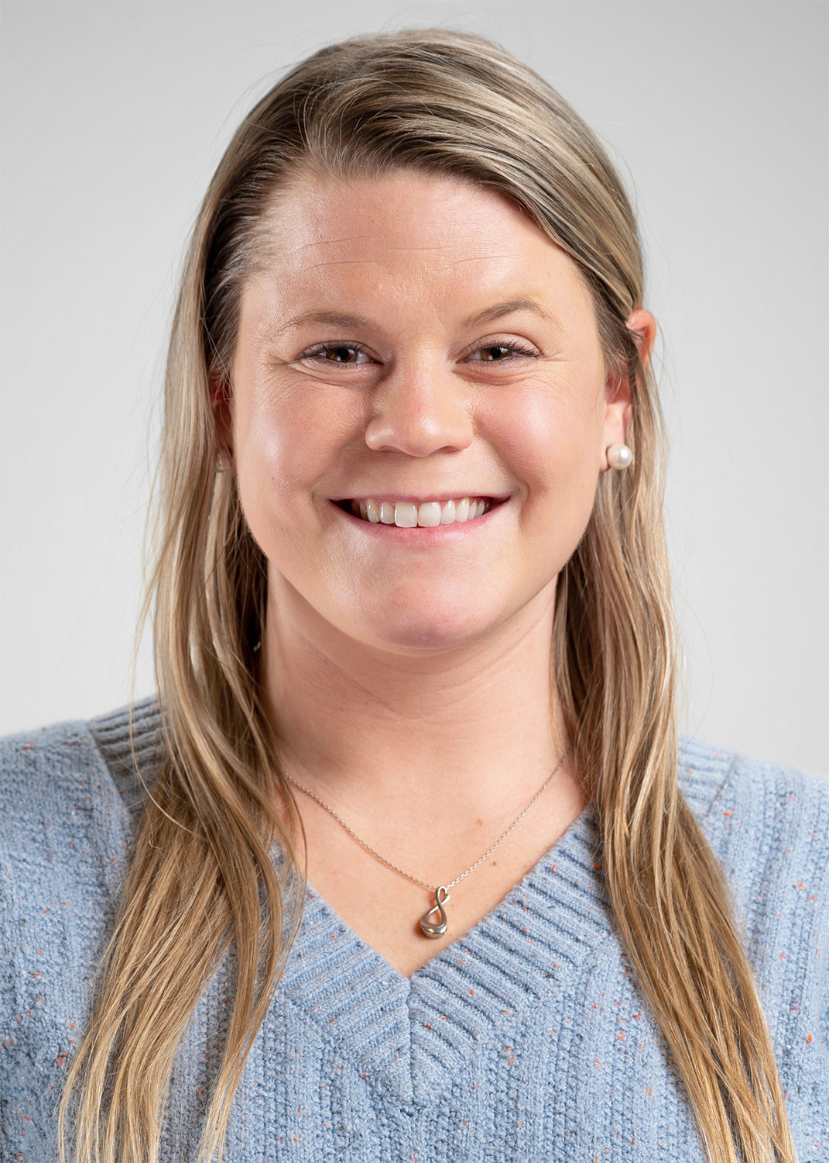

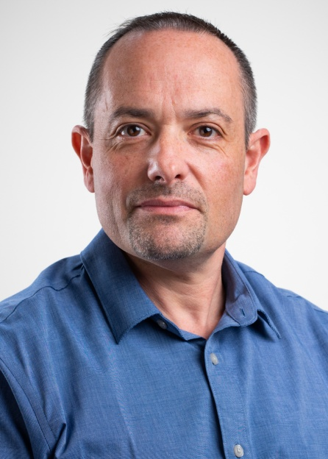

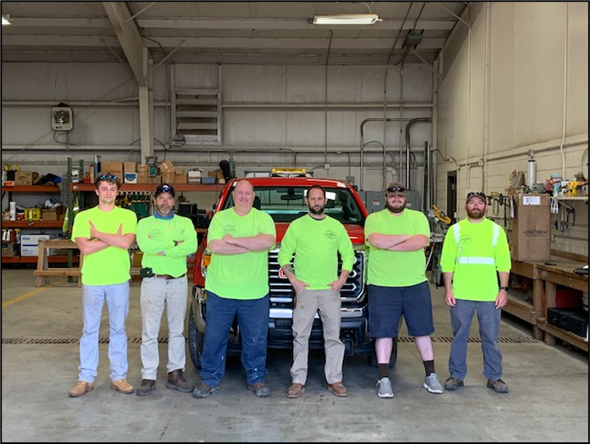
Borough Staff
Kathryn Vlahos
Borough Assistant to the Manager
kvlahos@hatfieldborough.com
215-855-0781 opt. 5
Diane A. Farrall
Borough Treasurer
dfarrall@hatfieldborough.com
215-855-0781 opt. 6
David Weiss
Borough Utility Billing Coordinator
dweiss@hatfieldborough.com
215-855-0781 opt. 4
Lindsay Hellmann
Borough Public Information Coordinator
lhellmann@hatfieldborough.com
215-855-0781 opt. 9
Pictured Left to Right: Ryan Witoslawski (21’ Summer Help), Derik Stover, Edward Polaneczky, Stephen Fickert (Public Works Director), Jack Engelhart, James Baskin

Slide 31
Steve Barth, Barth Consulting Inc

Slide 32

Hatfield Town
Hall Meeting
May 8, 2024 - 7:00 PM
401 SOUTH MAIN STREET

Slide 33
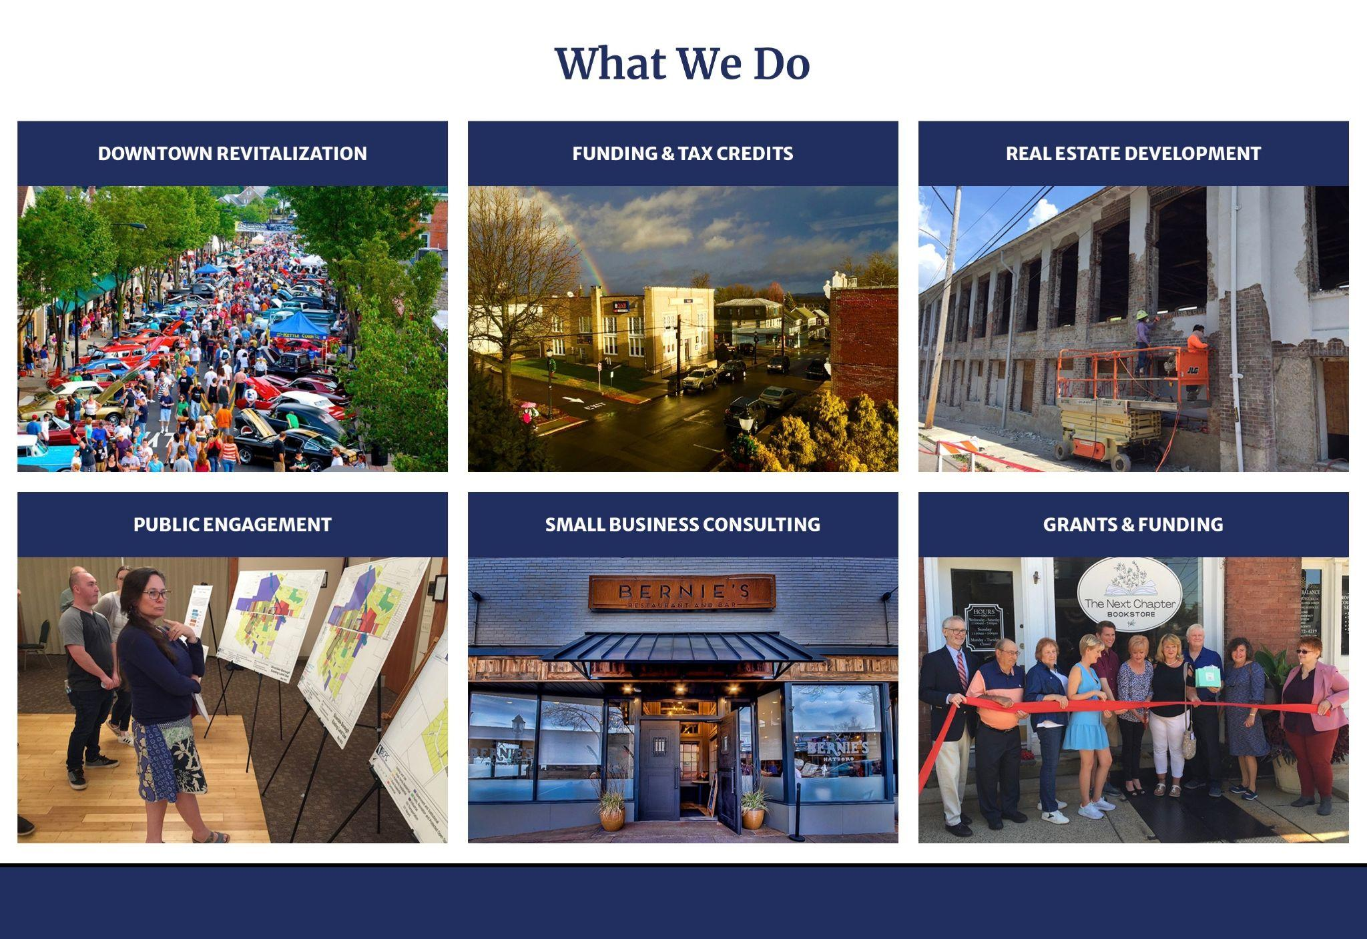

Slide 34
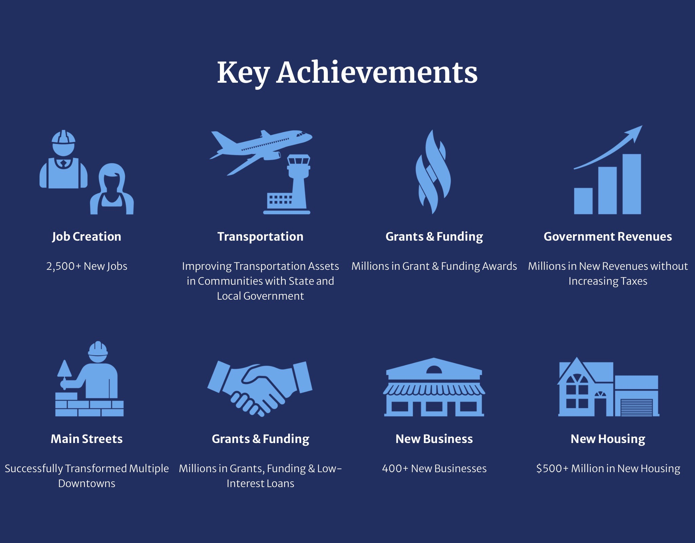

Slide 35
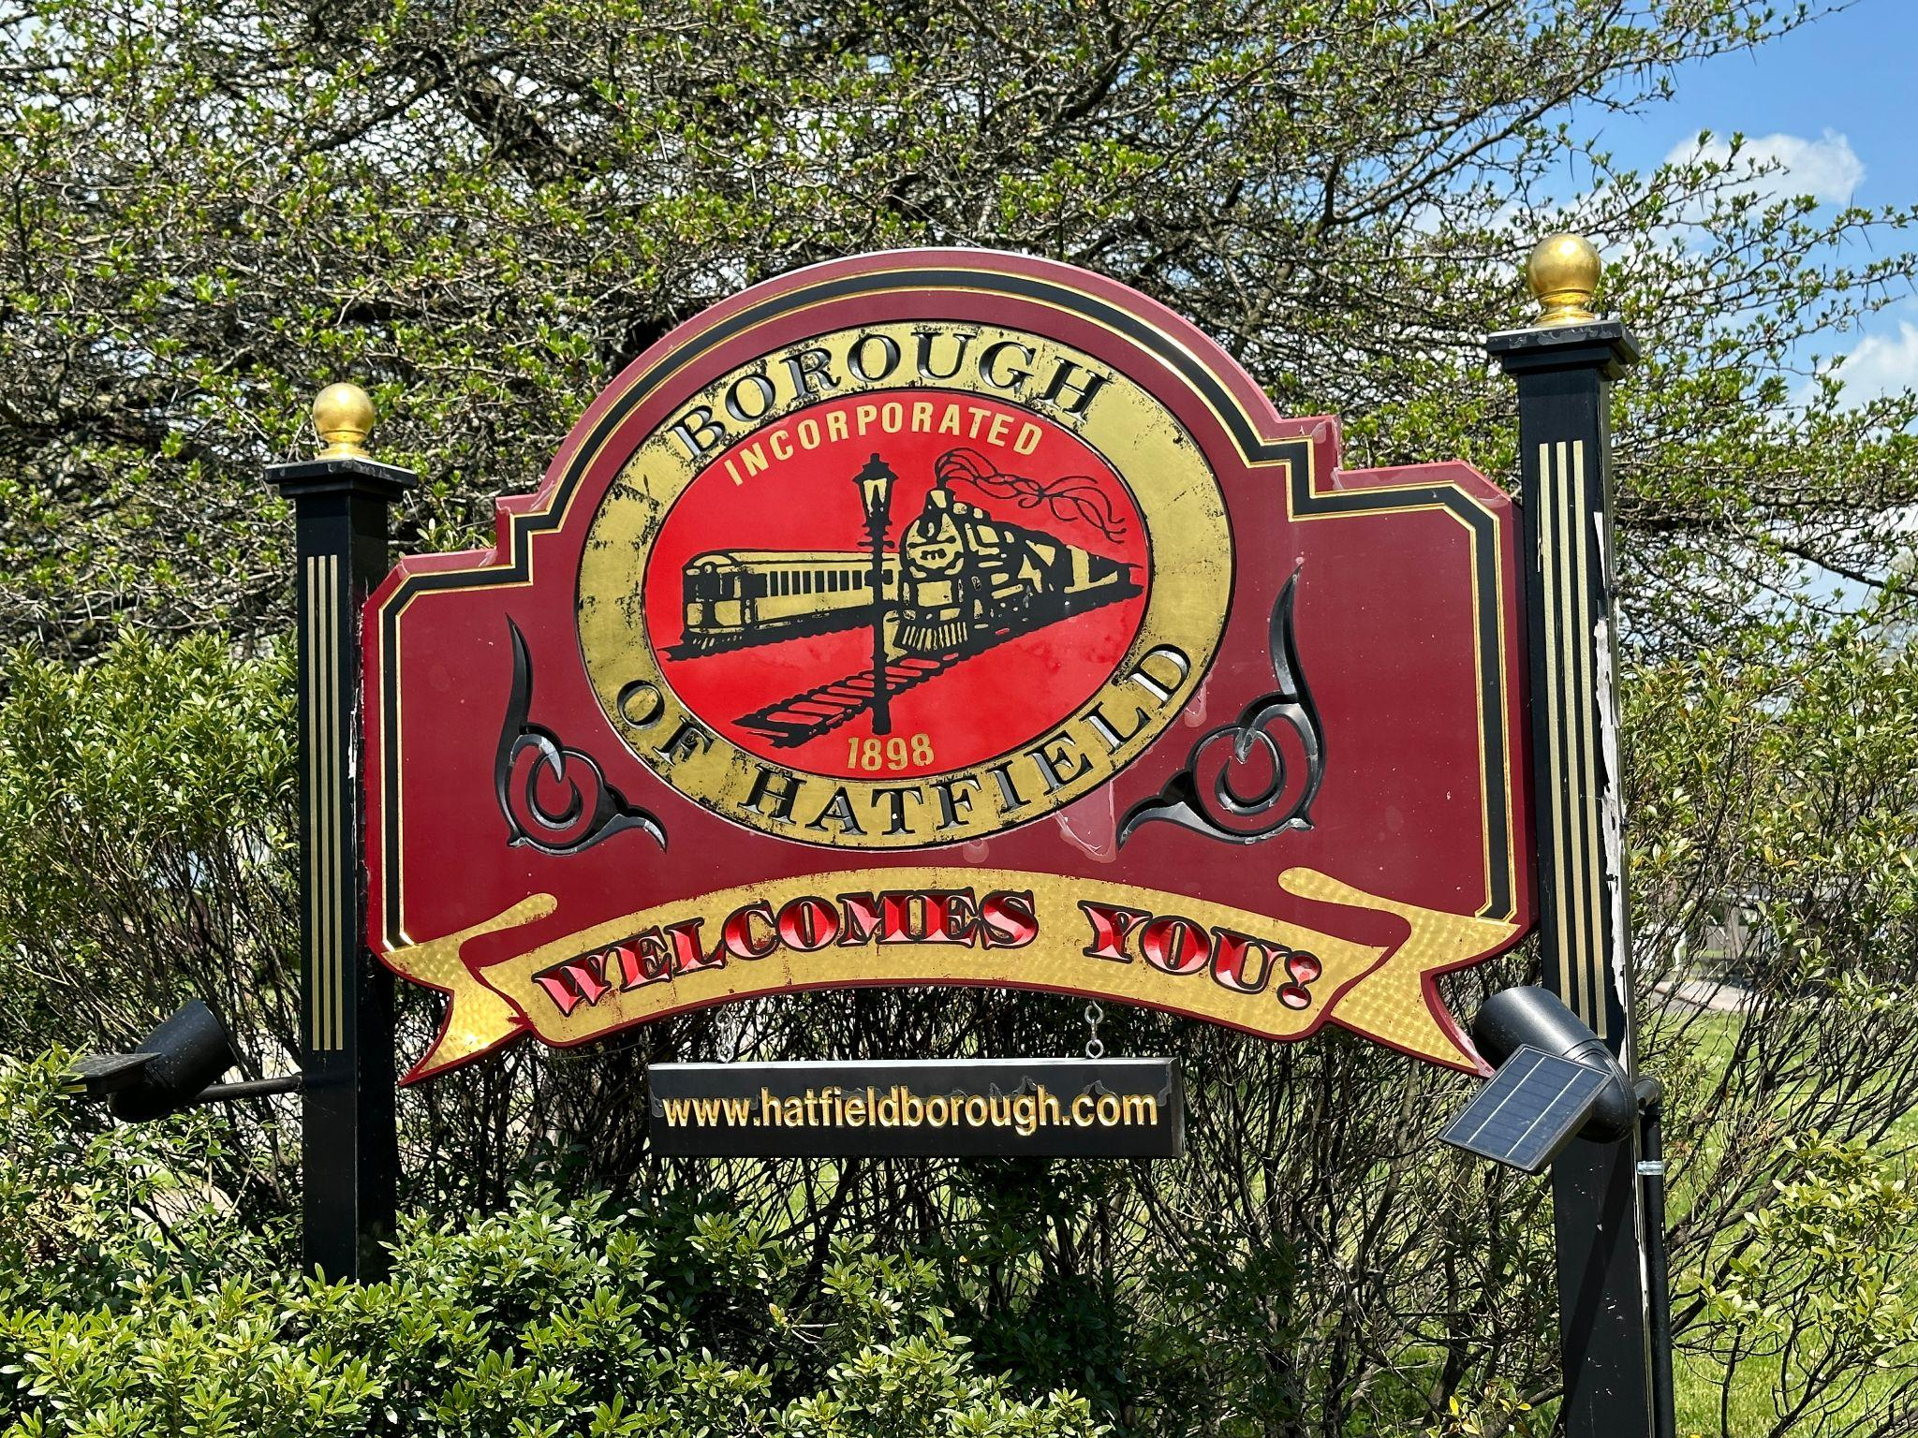

Slide 36
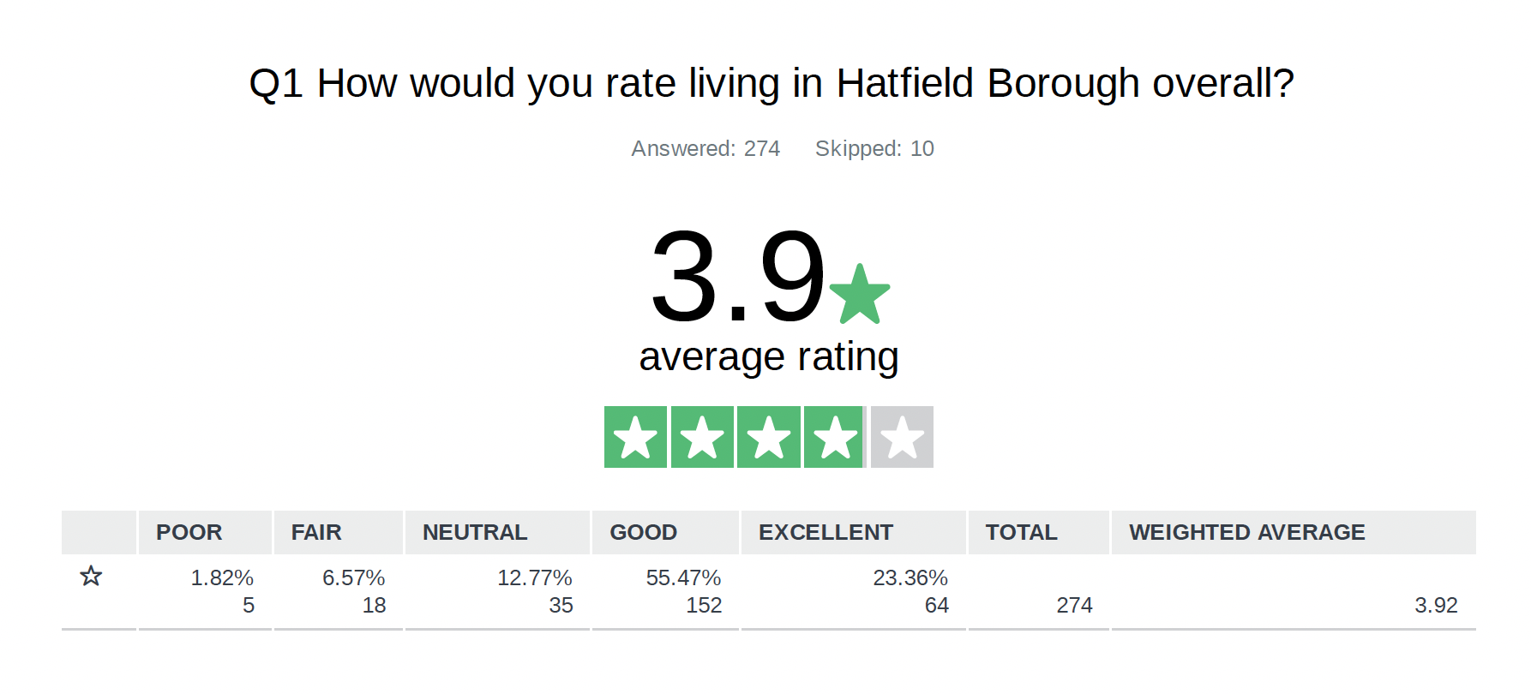

Slide 37
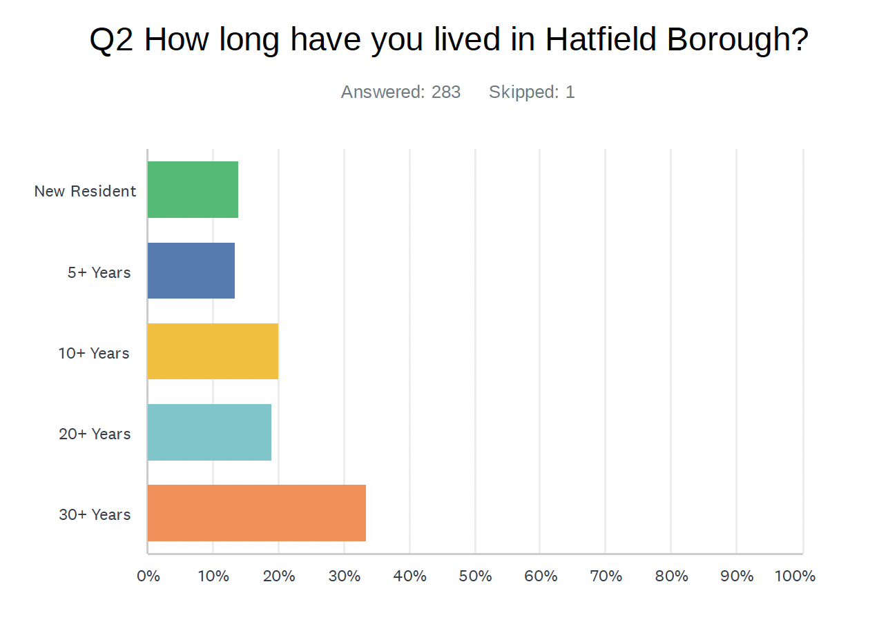

Slide 38
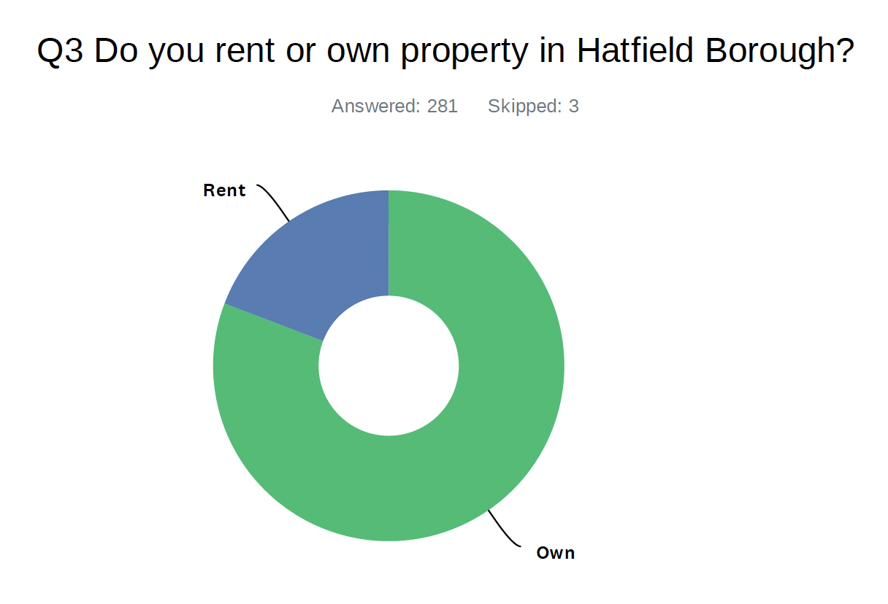

Slide 39
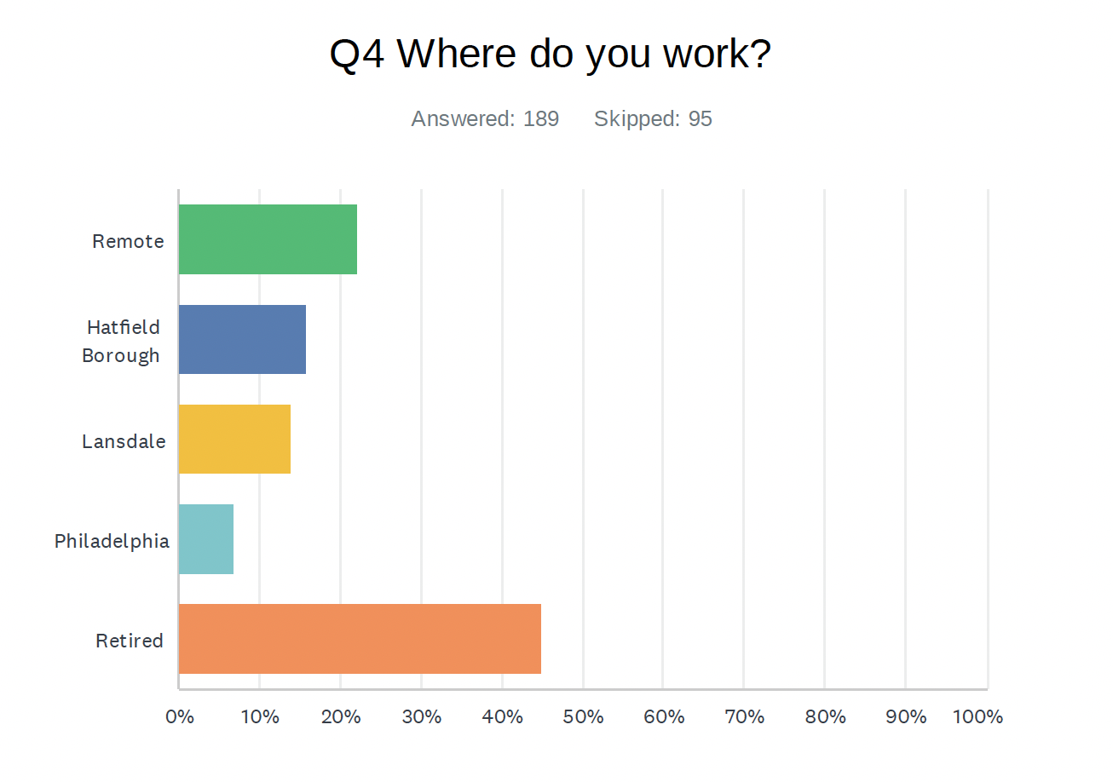

Slide 40
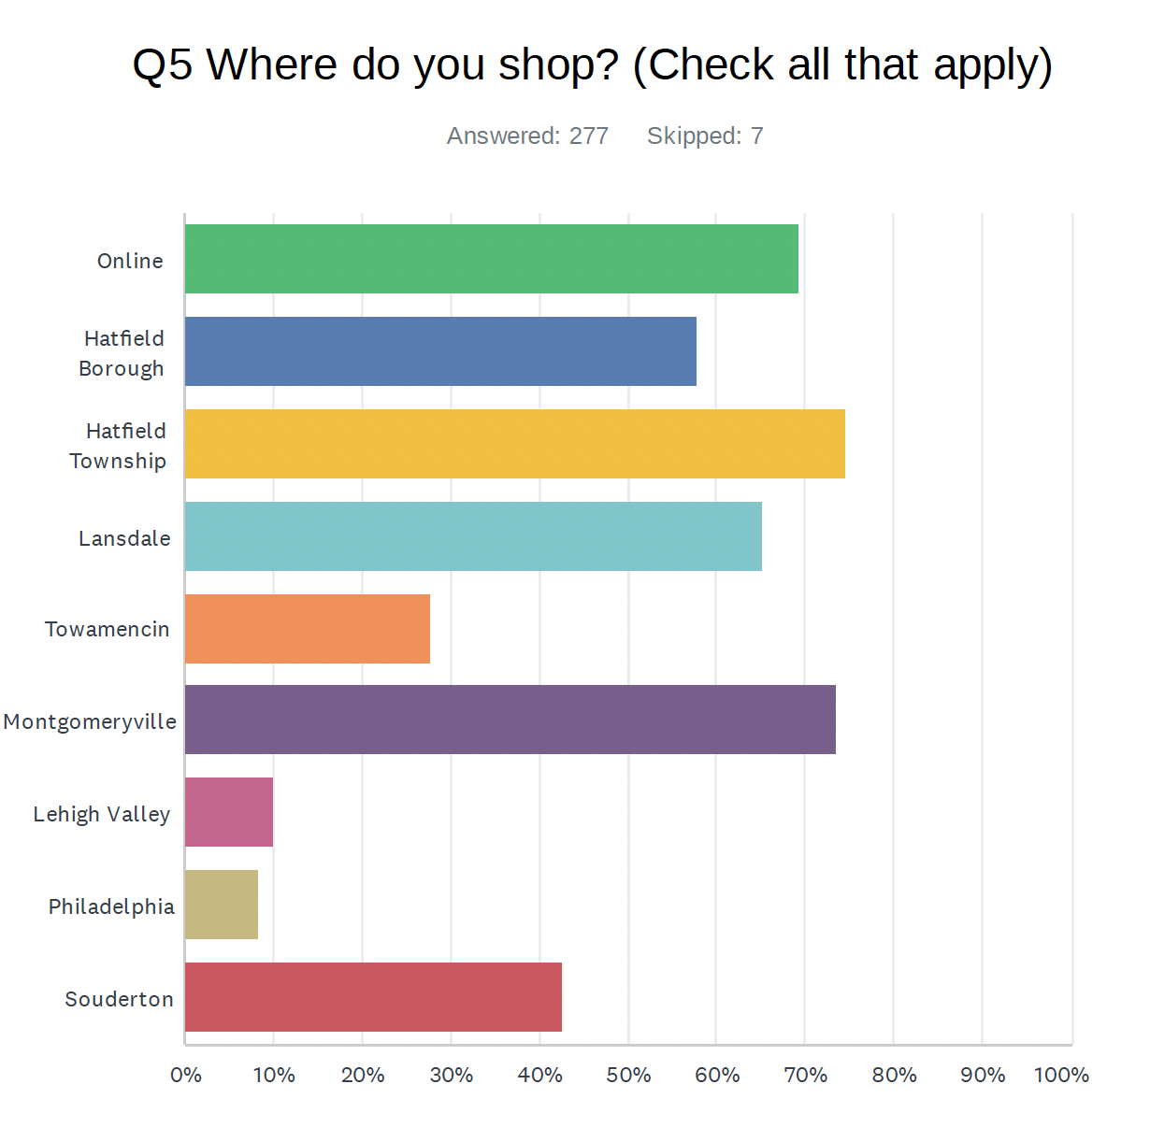

Slide 41
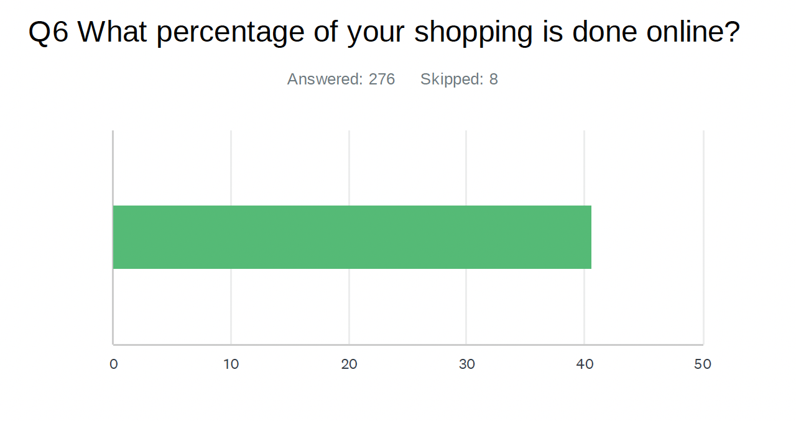

Slide 42
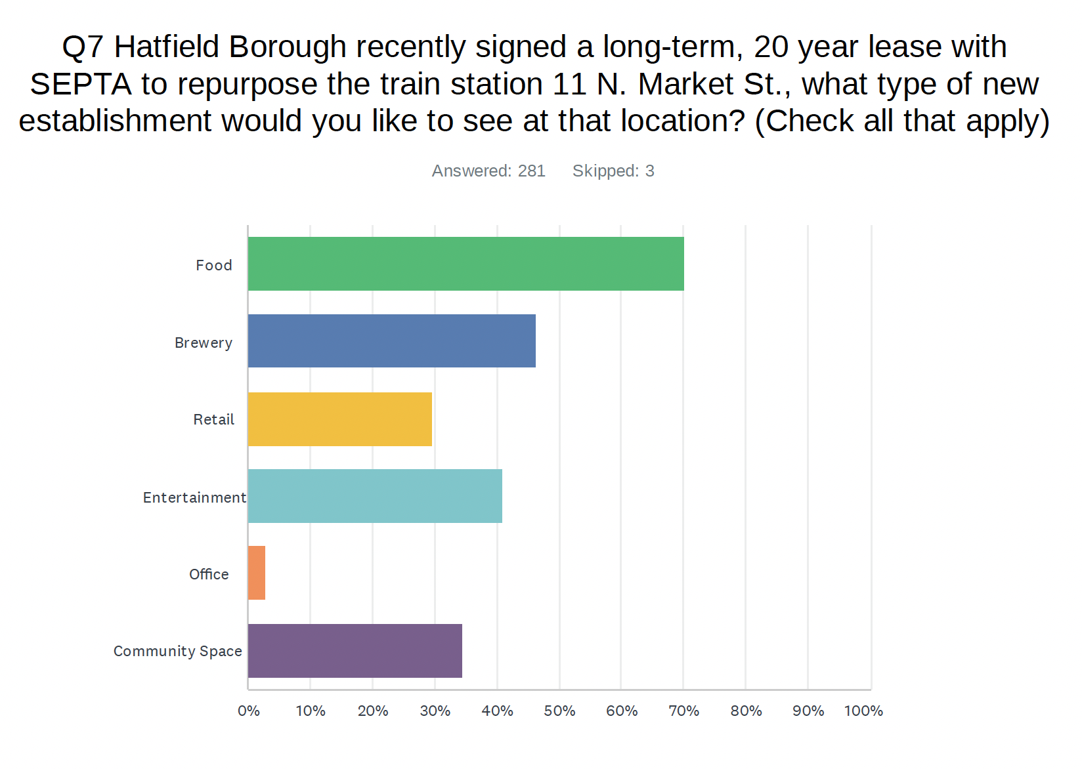

Slide 43
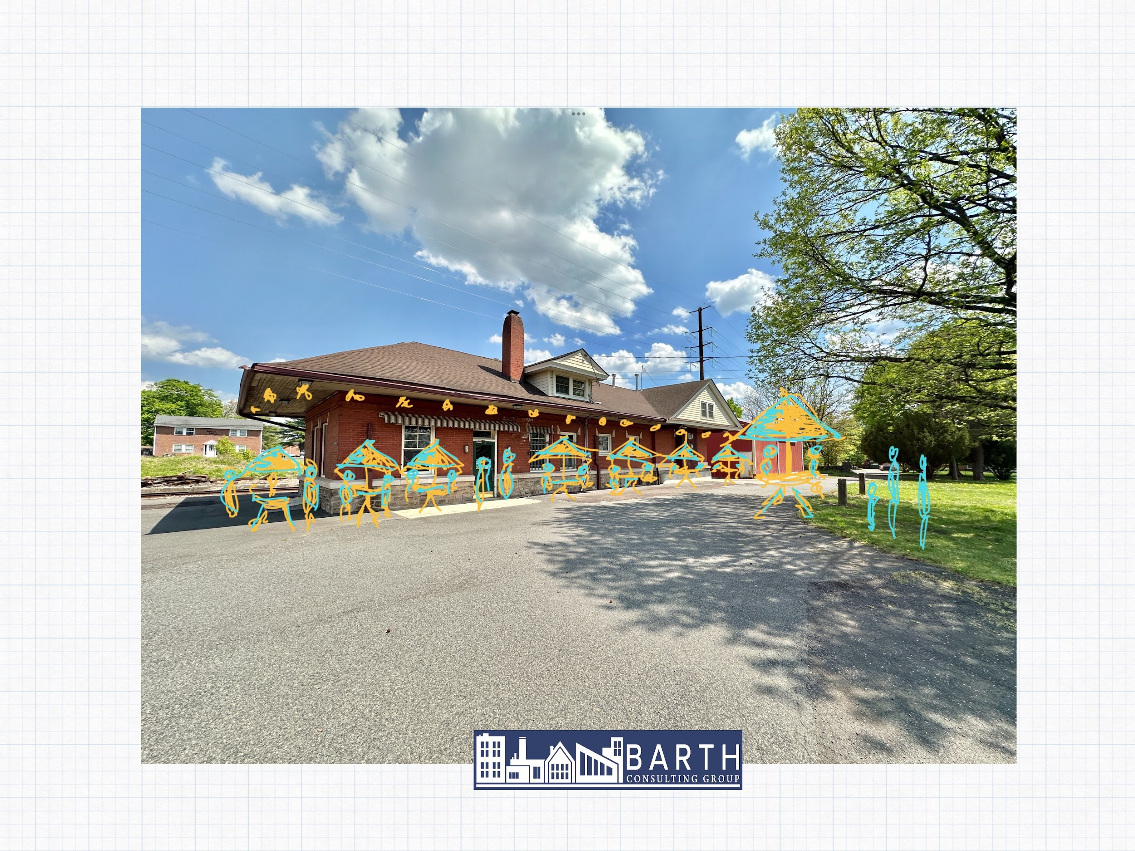
Hatfield Train Station

Slide 44
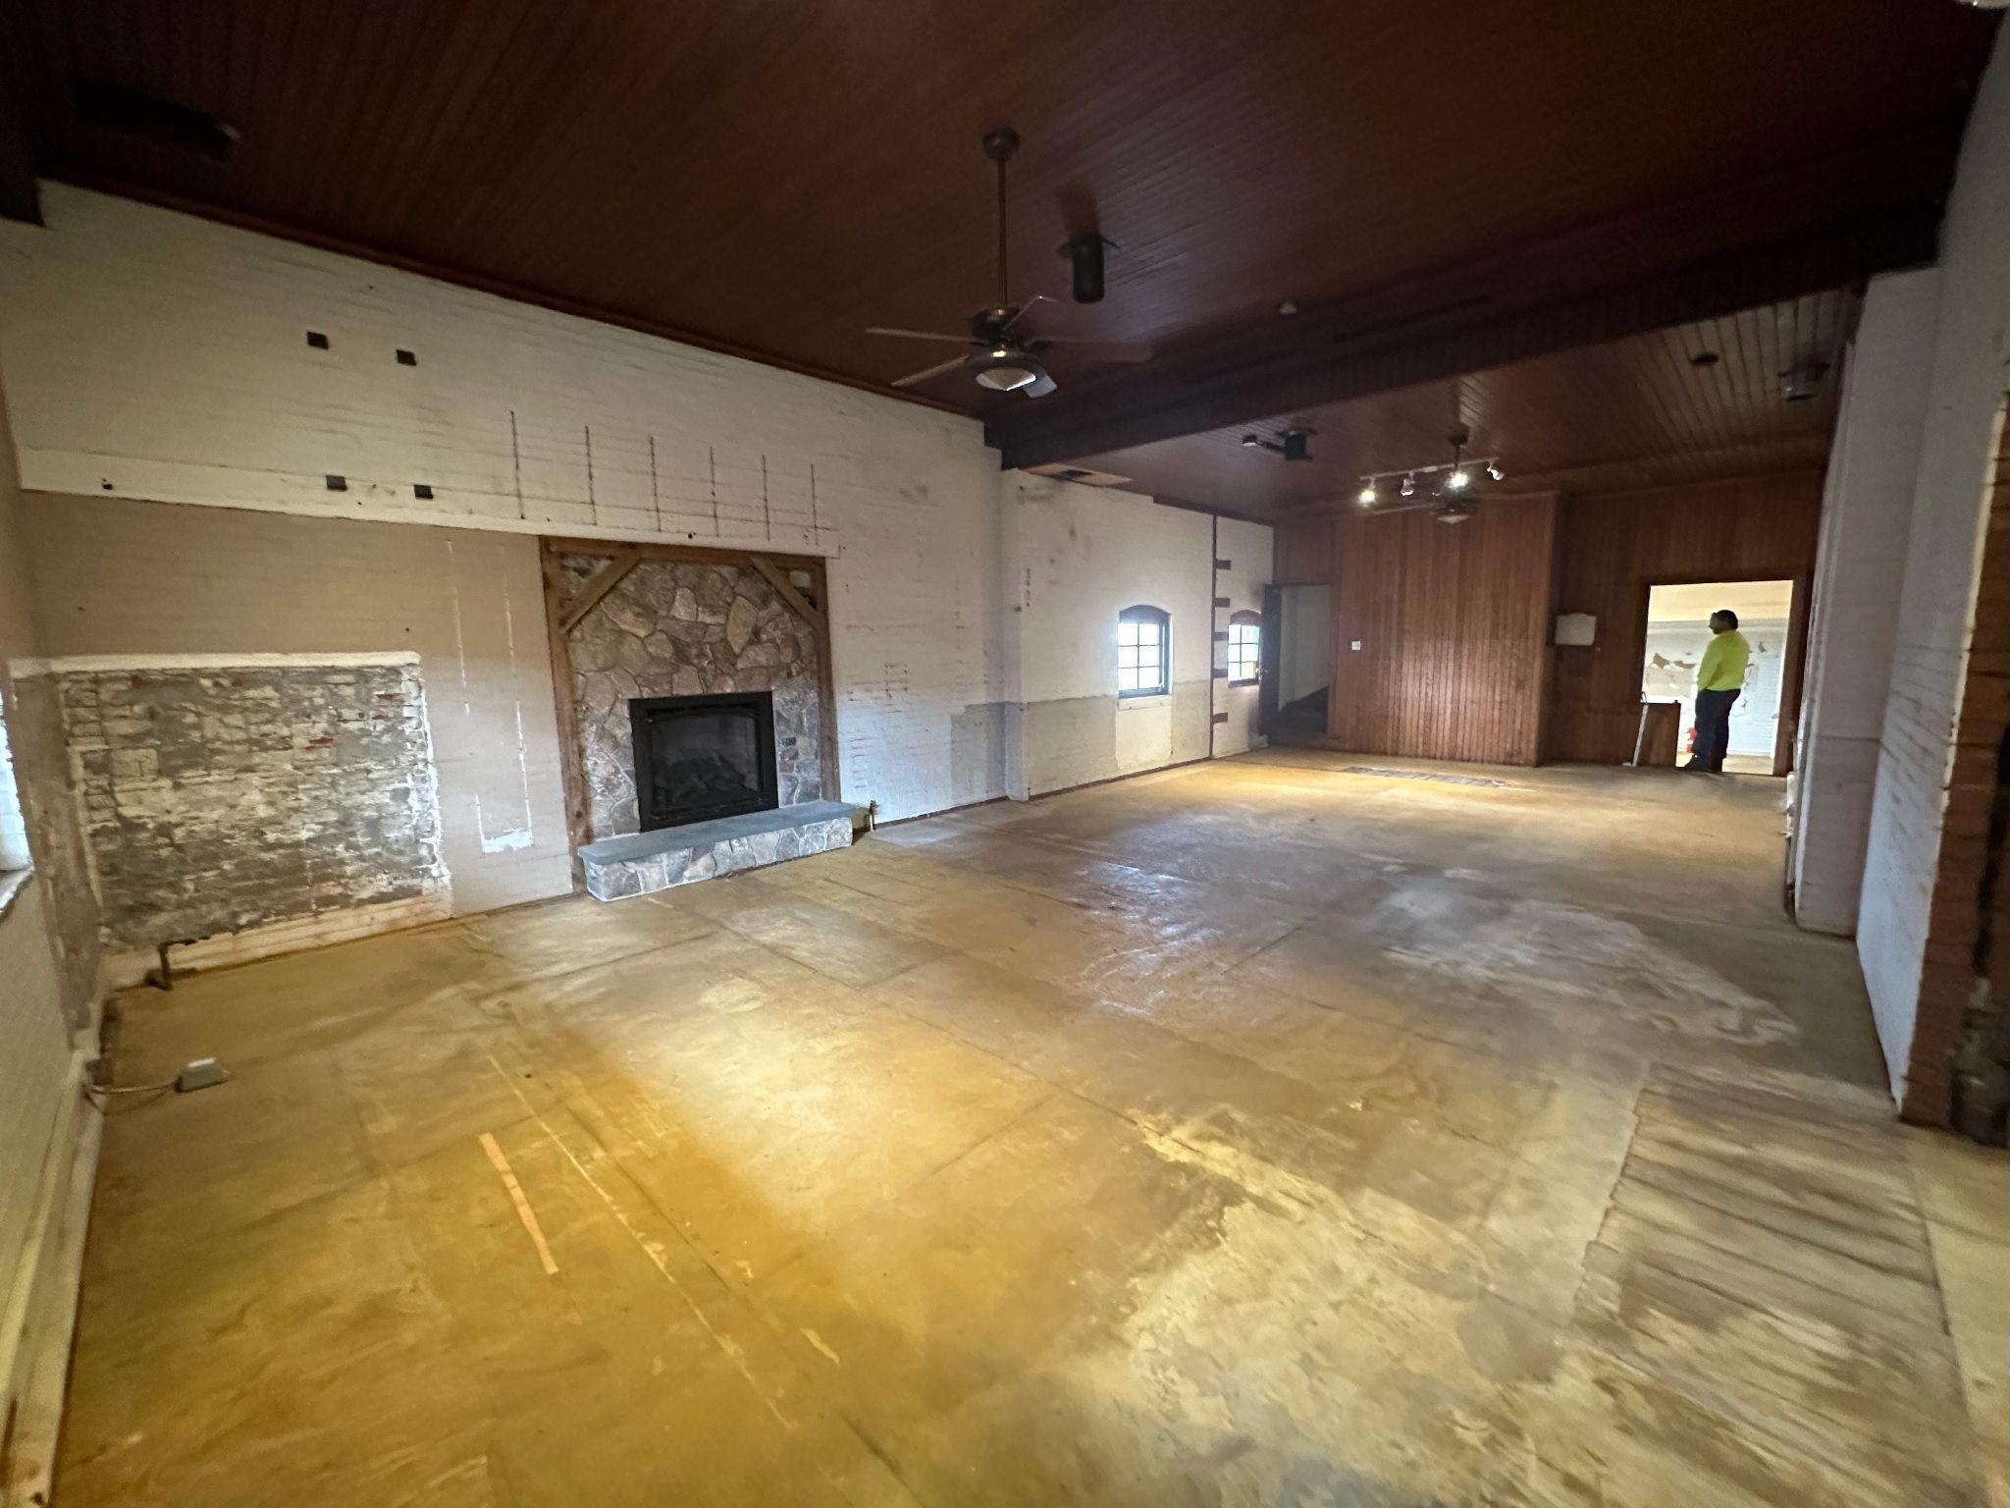
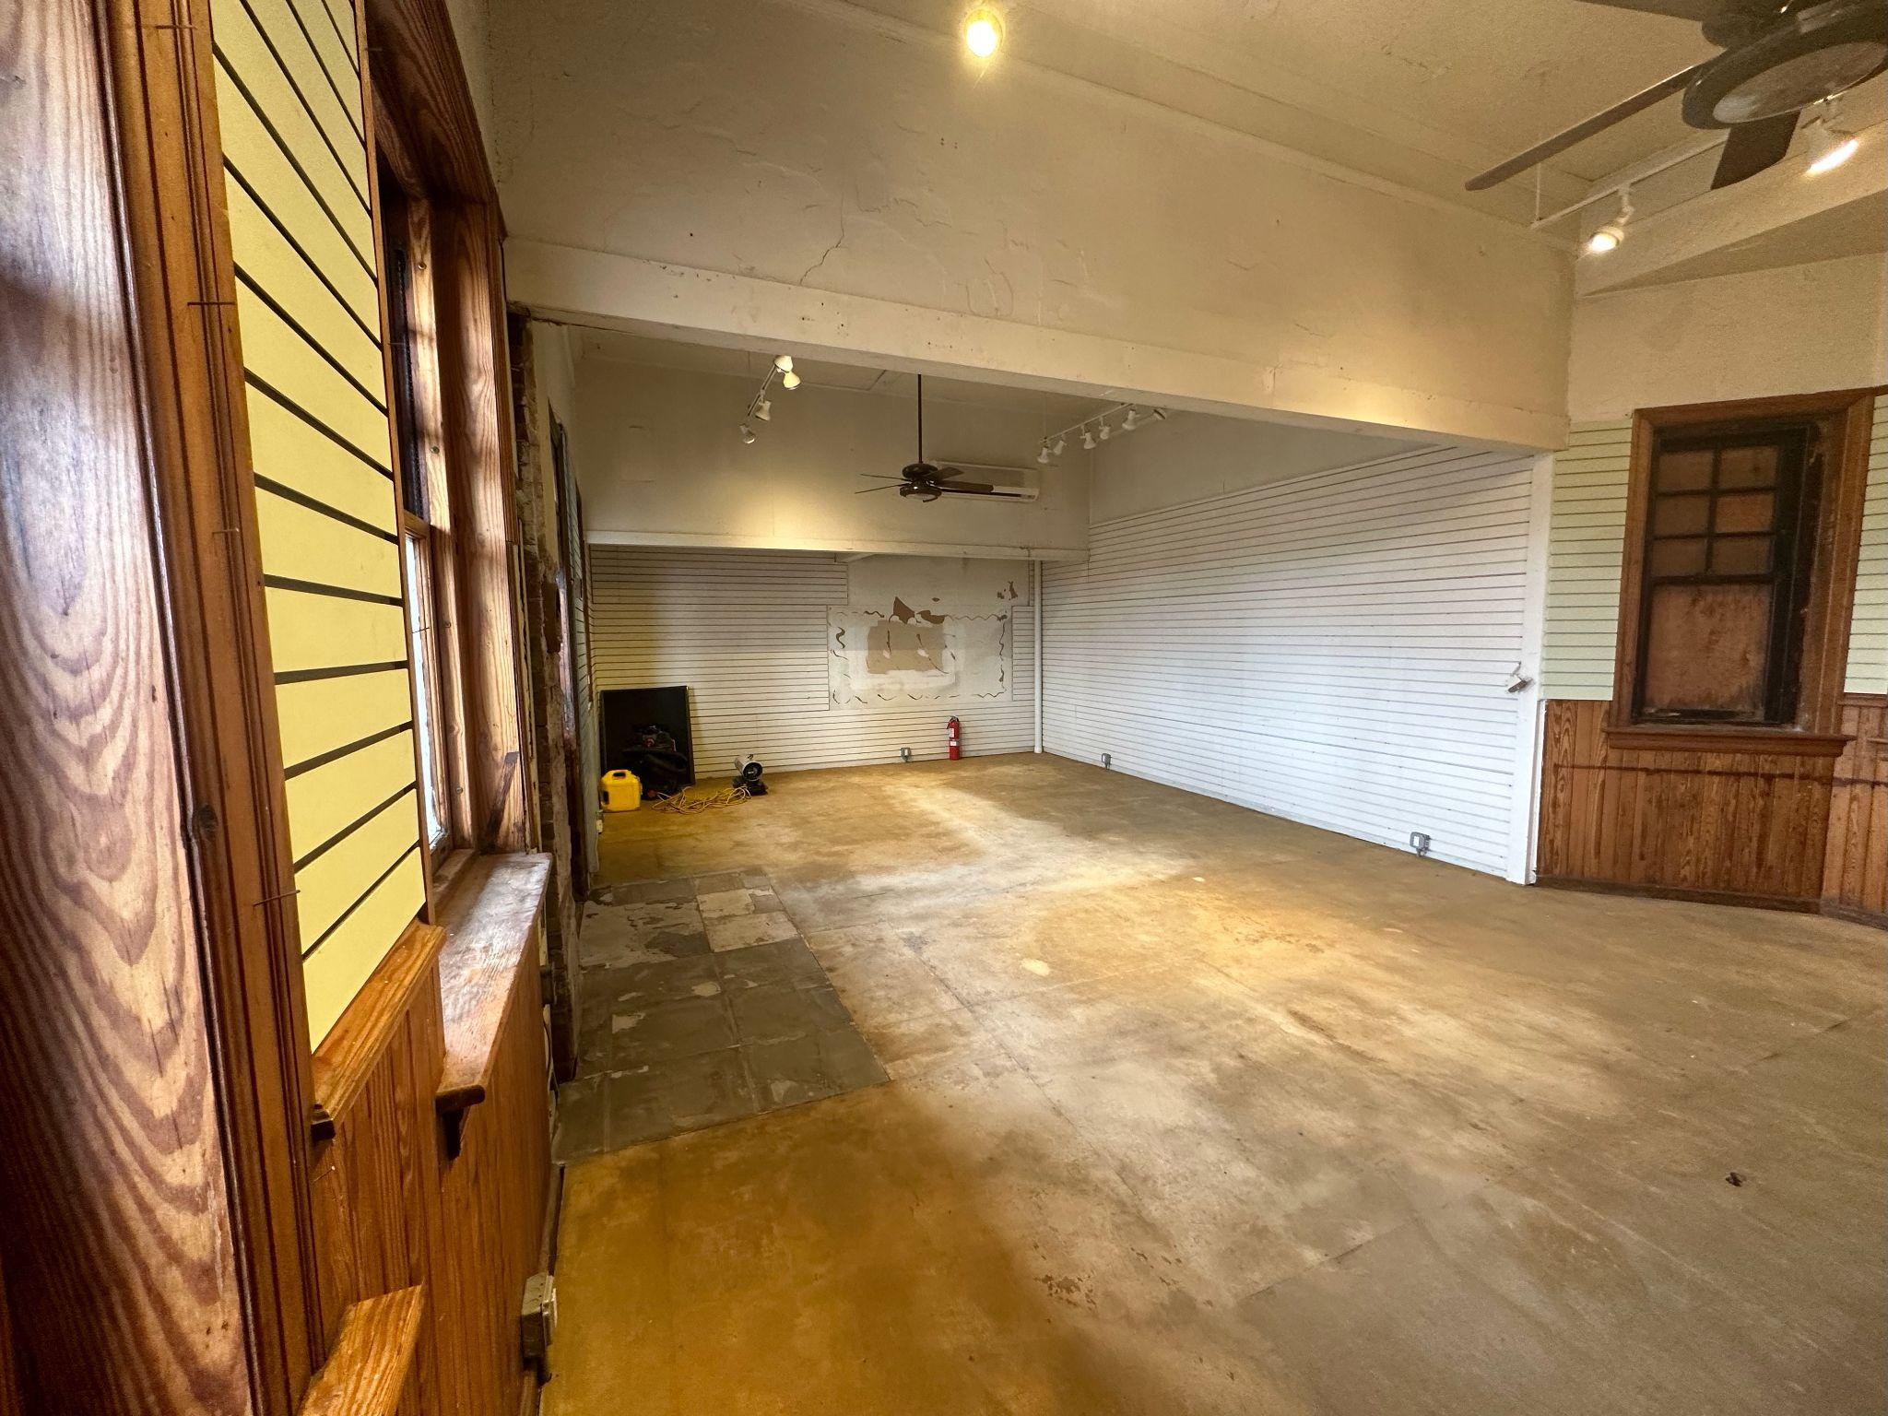
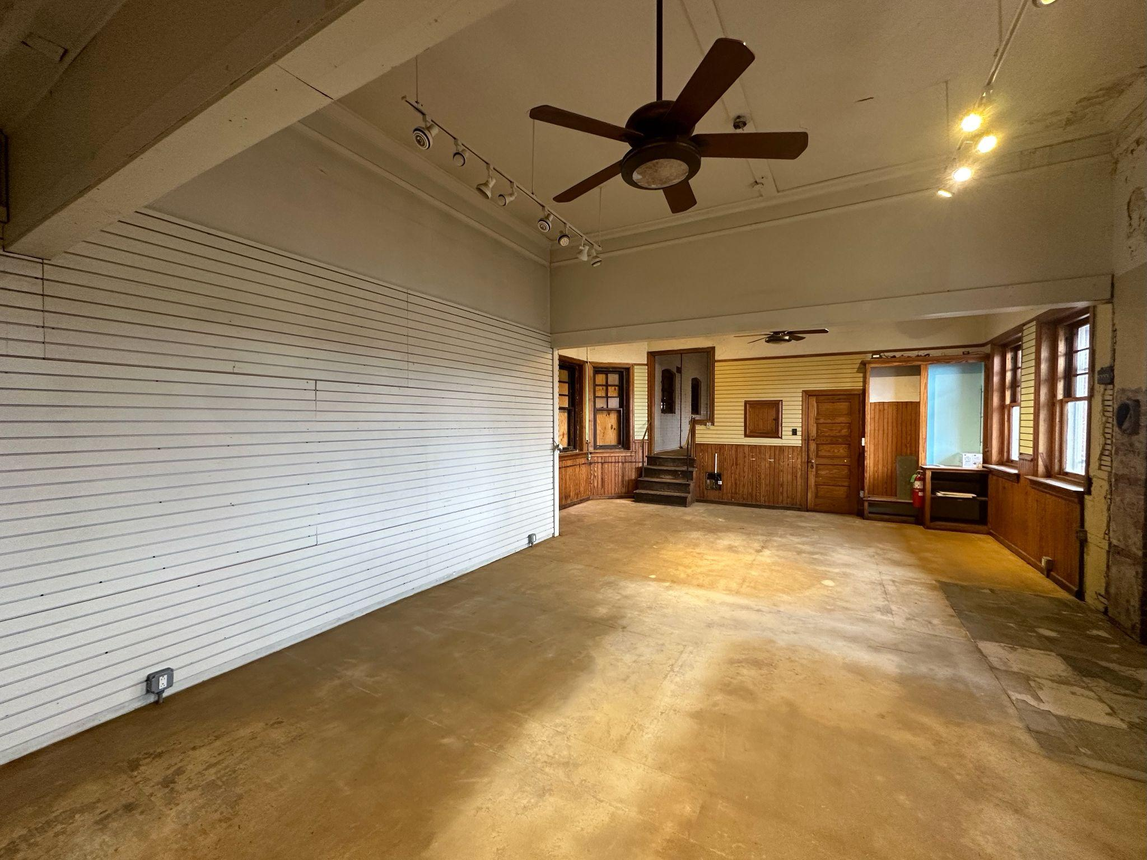
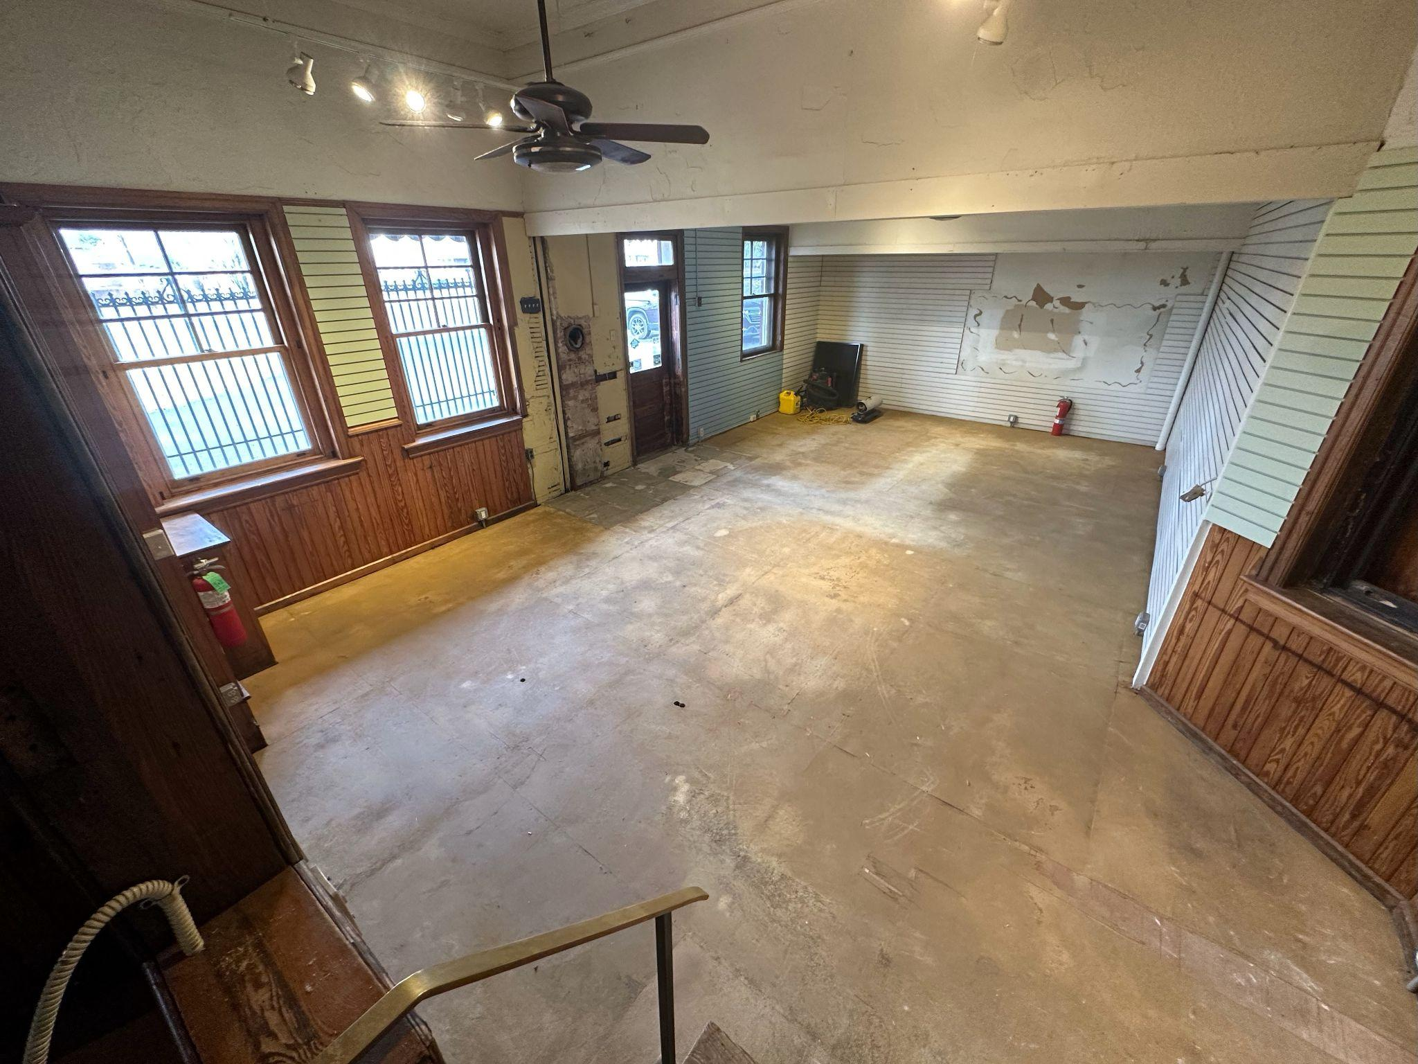

Slide 46


Slide 47

HEROC - Borough Branding

Slide 48


Slide 49


Slide 50


Slide 51


Slide 52


Slide 53

Architectural Treasures - Milton Bean

Slide 54


Slide 55

Hatfield’s Vision - Charting the Way

Slide 56


Slide 57


Slide 58


Slide 59


Slide 60


Slide 61


Slide 62


Slide 63


Slide 64


Slide 65


Slide 66


Slide 67


Slide 68


Slide 69


Slide 70

Liberty Bell Trail Improvements

Slide 71


Slide 72


Slide 73


Slide 74

Downtown Hatfield Overview

Slide 75


